Slide 1
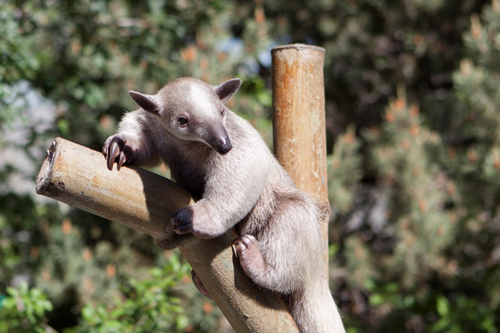
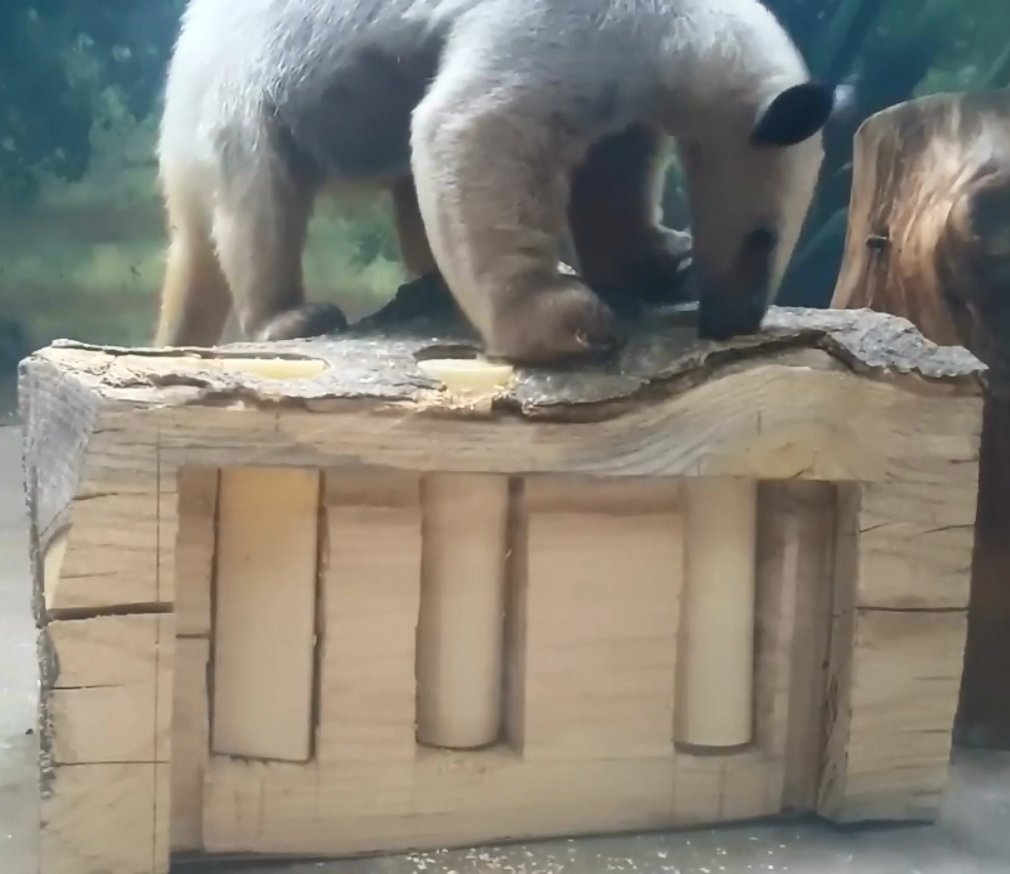
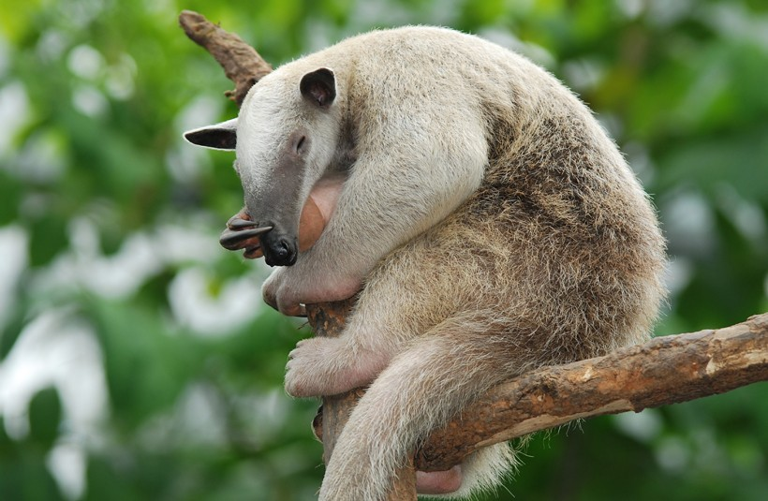
ZOO ENRICHMENT FOR THE SOUTHERN TAMANDUA
To design a safe and engaging enrichment device for the Southern Tamandua that will increase its day time activity, foraging, and
interactive behaviors within the Zoo and its public enclosure.
Introduction
The purpose of the partnership between the Denver Zoo and Northglenn High School is to design animal enrichment for Laird, the Southern Tamandua. Enrichment devices are crucial to an animal's development and quality of life because it allows the animal to display behaviors normally expressed in the wild. Currently, enrichment devices for Southern Tamanduas include devices that the anteater is able to explore with its tongue to get food, and boxes that the Tamandua can tear apart. However, these devices are not always reusable, and they don’t capture his attention for long. The goal was to design a safe and engaging enrichment device for the Southern Tamandua that will increase its day time activity, foraging, interactive behaviors, and quality of life within the Zoo and its public enclosure.
Results
After construction, it went through two installments at the Denver Zoo to gauge Laird’s reaction. Both times he interacted with the log multiple times over the course of 20 minutes. Between testing, the only change made to the log was the switch from solid colored 3D Printed cups to clear cups. The same Ethogram legend was used both in the baseline data as well as in these tests.
Scan Data: Initial Test 2/2/18 Scan Data: Final Test 3/21/18
Background
Laird is a Southern Tamandua at the Denver Zoo. Southern Tamanduas are nocturnal animals found mostly in South America. Their diet in the wild is comprised of mostly small insects but occasionally includes fruit and honey. Using their extremely long tongue and claws, the Tamandua's natural behaviors consist of foraging for food in both trees and the forest ground and exploration through scent and taste.
Enrichment ideas that were researched included a clear tube drizzled with honey to show off his tongue, as well as cardboard boxes filled with newspaper and food to encourage natural foraging and searching behavior of the Tamandua. The enrichment device must be safe for all animals in the enclosure, which includes both Laird the Southern Tamandua and the two Pale-Faced Saki Monkeys, withstand the strength of the Southern Tamandua, and be made from extremely durable material while encouraging natural behaviors.
Scan here to see the website about this project, including design specifications and a weekly blog.
Conclusion
The log enrichment was a success due to the way it increased the daytime activity of the Tamandua, as well as encouraging the natural foraging behavior and other attributes that the Tamandua would exhibit in the wild. Moreover, this allows the general public to see his tongue, which is very unique to the Tamandua species. The success of the enrichment is shown through the increase in Lairds activity before the introduction of the log and after. With the baseline data Laird spent almost the entire time sleeping whereas each time the log was introduced Laird was actively engaged with the log enrichment for a considerable amount of time. The simplicity of the log and cups allows the device to have durability to constant use as well as ease of cleaning. This design provided the safest and greatest encouragement of natural behaviors and activity.
Hypothesis
Null: The Southern Tamandua will have no increase of daytime activity and or has little interaction with the enrichment.
Alternative: The Southern Tamandua will have a significant increase of daytime activity an interaction within his habitat.
Ethogram Scan Data: Baseline Data 11/15/17
If the Tamandua is interacting in any way with the enrichment, that behavior will be recorded with an E following the behavior code.
Device Description
The final design of the log is just over a foot in length, and about 8 inches in height, though it varies due to its naturally uneven surface provided by the bark. The plexiglass is set about ¼ of an inch into the face of the log, with about two inches on either side. Three holes are cut into the top of the log ½ of an inch behind the face. The holes have a diameter of 2 ⅛ inches, and have been fitted with clear PVC pipes, melted to form complete cups that have a diameter of 1 ⅞ inches.
The design also lends itself to safety, which was the first concern in adding enrichment to the exhibit. Every part of the log is safe for the Tamandua including the use of a track slide for the plexiglass, as well as the clear PVC which has been melted as to not use glue. The use of a dense wood allows the log to have a stability that enables Laird complete freedom in interaction with the log.
Acknowledgements
Thank you to James McGorry for assistance in building, Michael Cengia and William Thielke for mentorship and guidance and the Denver Zoo for resources and providing an amazing, unique opportunity to further our education while delivering unending support in the process.
References
Faith, Mary. “Care Sheet - Tamandua.” Care Sheet - Tamandua | Phoenix Exotic Wildlife Association, Phoenix Exotic Wildlife Association.
IUCN Red List. “Collared Anteater Video.” Arkive, Wild Screen Active.
Rundquist, Jacqueline, et al. “Denver Zoo Animal Introduction.” 15 Nov. 2017.
Southern Tamandua | Lesser Anteater of the South.” Tamandua Tetradactyla, About Animals, Communication and Intelligence.
The Sacramento Zoo. “Tamandua Enrichment, Honey in a Tube - Sacramento Zoo.” YouTube, YouTube, 14 Mar. 2011.
Northglenn HS STEM 601 W. 100th Place Northglenn, CO 80260
Josephine Martin, Kira Braun, Olivia Johnson, Adrianna Burney

