Slide 1
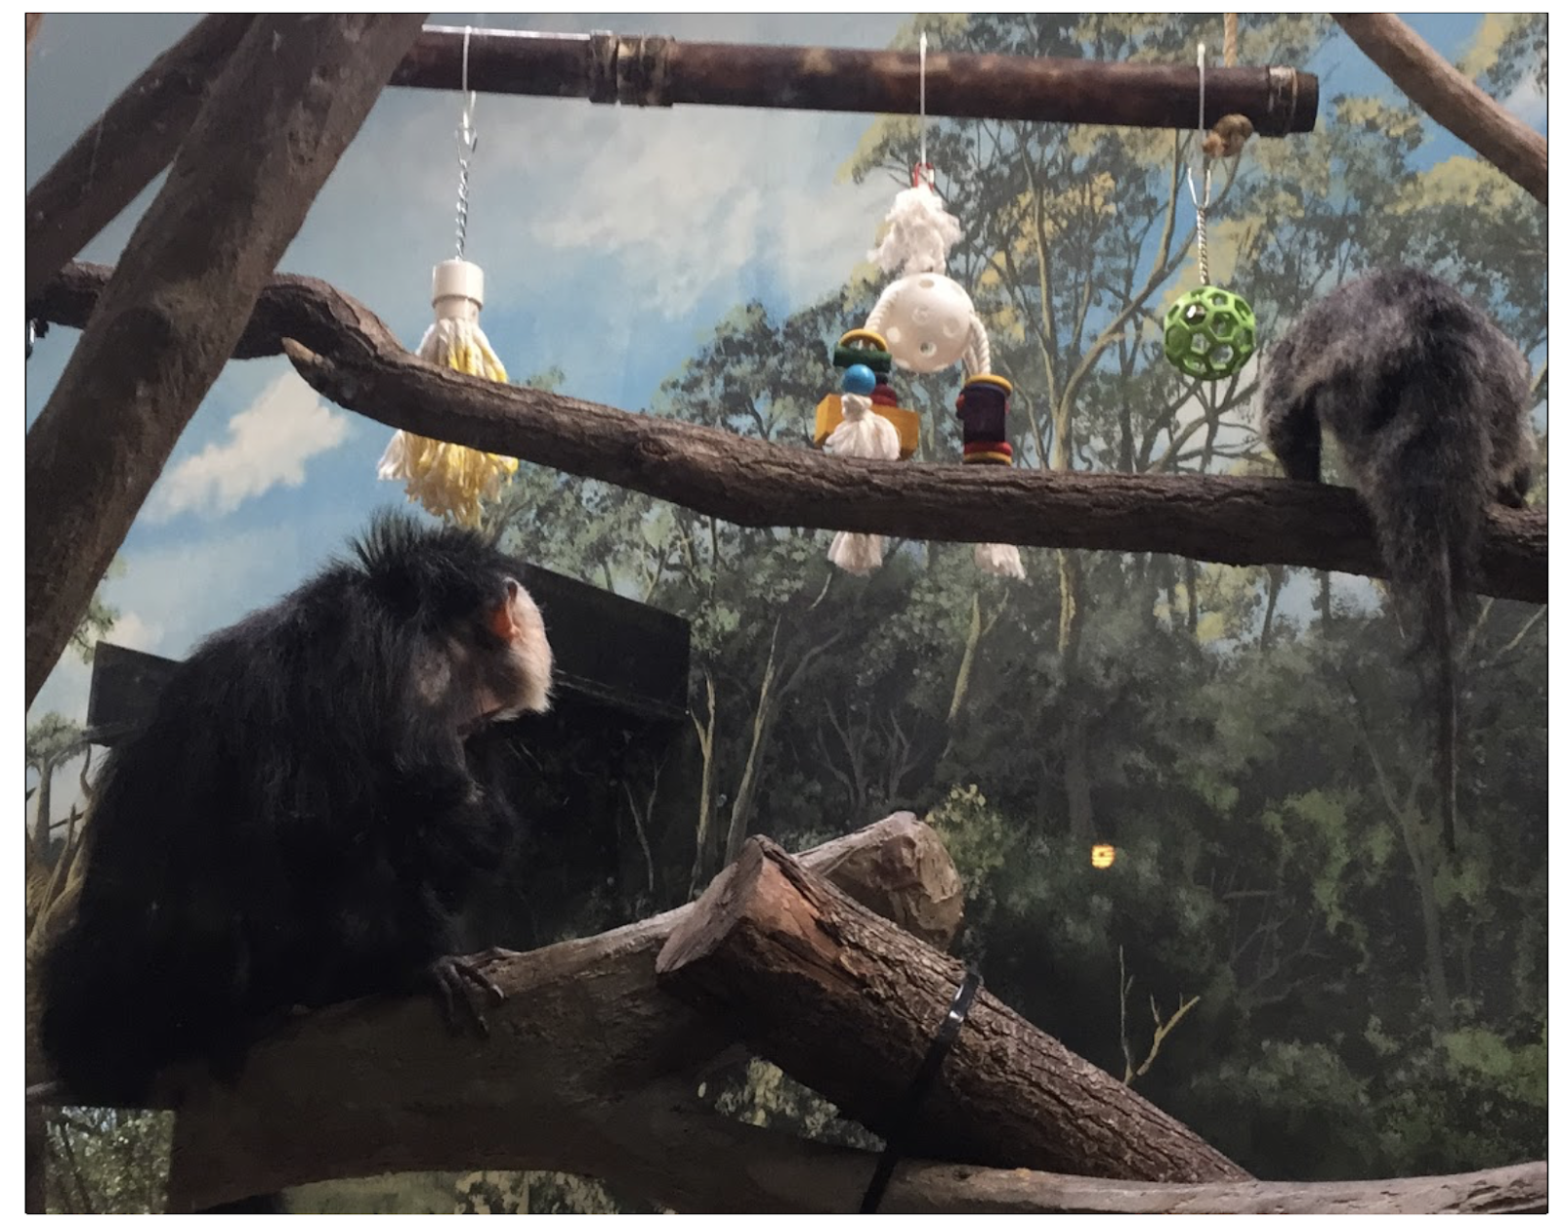
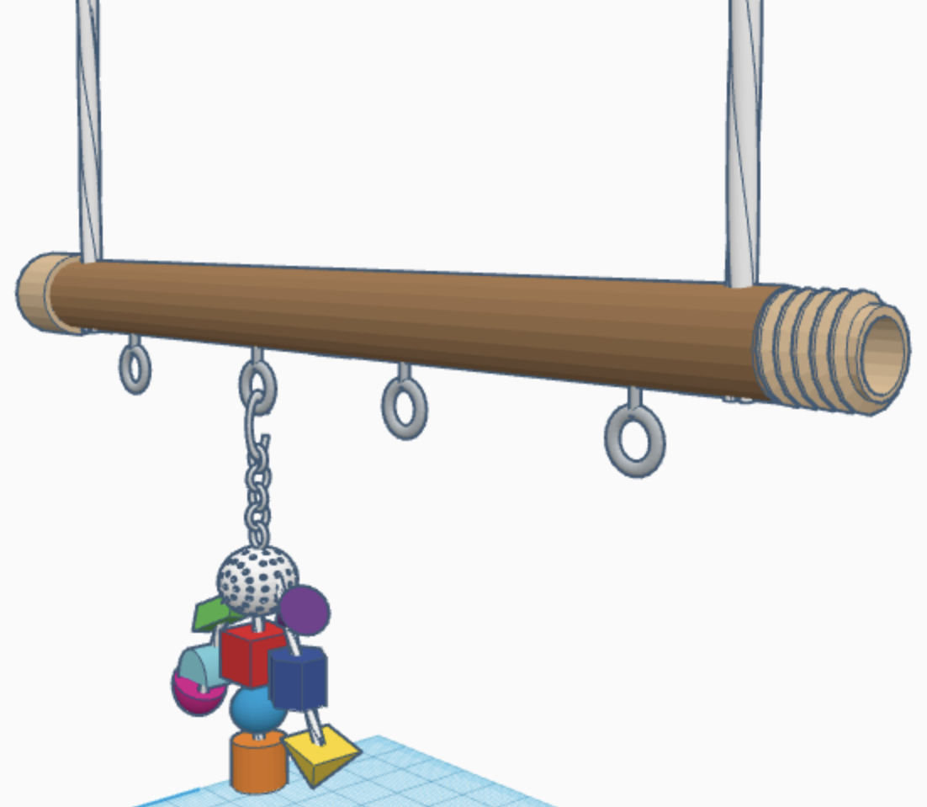
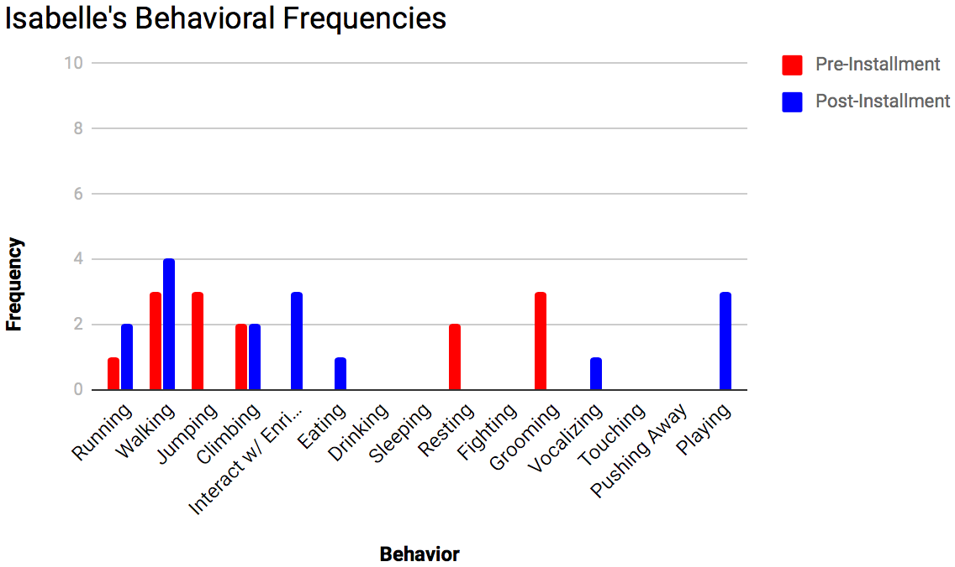
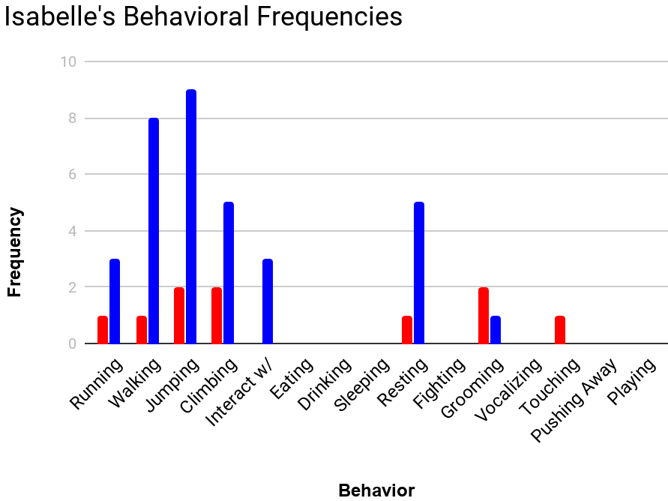
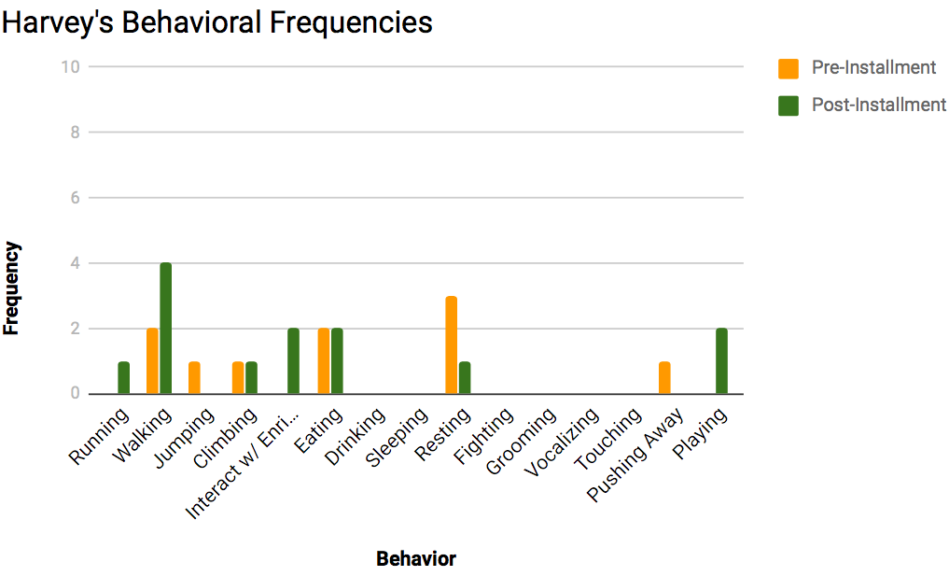
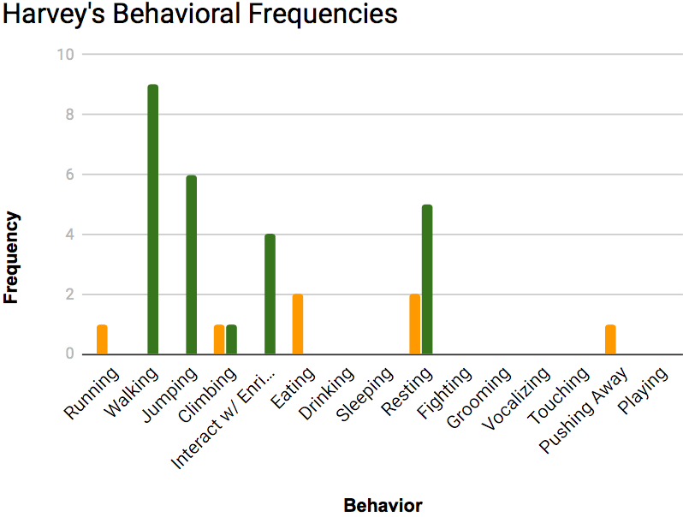
Pale Faced Saki Monkey Prolonged Enrichment Activity
Problem Statement: Create an enrichment that would prolong the monkey’s activity to prevent grooming
Purpose/Introduction
Monkeys at the Denver Zoo, Harvey and Isabelle, are bored in their habitat. This led to the monkeys over grooming each other and themselves to the point where they are balding. To solve this, the zookeepers at the Denver Zoo are looking for an enrichment that would prolong the monkey’s activity versus them just grooming themselves and each other.
Design Process and Next Steps
The original idea was an adjustable, artificial branch with toys that attached via zip tie, and they would hang down for the monkeys to interact and play with. We would have four sections of the pole, a one foot, 2 two foot, and a five foot section. The sections could be attached or detached to lengthen or shorten the length of the enrichment.
Upon revision, a “trench” would be cut out on the bottom of the pole. This trench would then allow the toys to be attached using nuts, bolts, and washers.
Background/Literature review
The Pale Faced Saki monkey originates from the rainforests of South America. Their dies consists of fruit, berries, honey, leaves, flowers, nuts, insects, seeds, small mammals, birds, and bats. The Pale Faced Saki monkeys live in small groups of a pair or a small family. Families will have one to three offspring.
The Pale-Faced Saki is a small mammal, weighing about four to five pounds. Their tail is about the same length as their body at 12-16 inches long. In the wild these monkeys can live about 15 years and 10 years longer when in captivity.
Analysis
The observed Pale Faced Saki monkeys spent most of their time resting and grooming prior to the introduction of their new enrichment. The monkeys placed themselves in the middle window of their enclosure on display for passing-by viewers to watch them do their natural behaviors. After the first install of their new enrichment change in behavior was immediately recognized. The monkeys were hesitant at first to approach the enrichment yet, it still captured their attention and kept them active and away from over-grooming each other. During the second installment of the enrichment, the monkeys were not timid of the enrichment or observing it from afar. During this installment they appeared more comfortable with the enrichment and more willing to approach it, interacting with it and the toys on it.
Results
Methodology
Ad-Lib: this type of data collection will be used for a specific amount of time, while behavior is recorded at certain time intervals. It is used to determine which behaviors are most frequently used by the subject within the overall time interval.
All-Occurrence: data collection is used when all behaviors are recorded within a certain period of time. It is used to determine which behaviors are repeated most often and used the most within a certain amount of time.
Acknowledgements
We would like to thank Amy Lear and Tom Schermerhorn from The Denver Zoo, our teachers Michael Cengia and William Thielke, the Denver Zoo Pale Faced Saki keeper, Jacqueline Rundquist, and Hilda Tresz from the Phoenix Zoo for her ideas and generous help with research on enrichments.
References
Grubich, N. (n.d.). Pithecia pithecia (Guianan saki). Retrieved December 04, 2017, from http://animaldiversity.org/accounts/Pithecia_pithecia/
Pale-headed saki monkey. (2017, May 04). Retrieved December 04, 2017, from https://nationalzoo.si.edu/animals/pale-headed-saki-monkey
Saki Monkeys - Small Monkey Facts,Information & Habitat. (n.d.). Retrieved December 04, 2017, from https://animalcorner.co.uk/animals/saki-monkeys/
Northglenn HS STEM 601 W. 100th Place Northglenn, CO 80260
Madison Hoy, Caleb Leialoha, Emiliano Montes, Megan Smith

