Slide 1
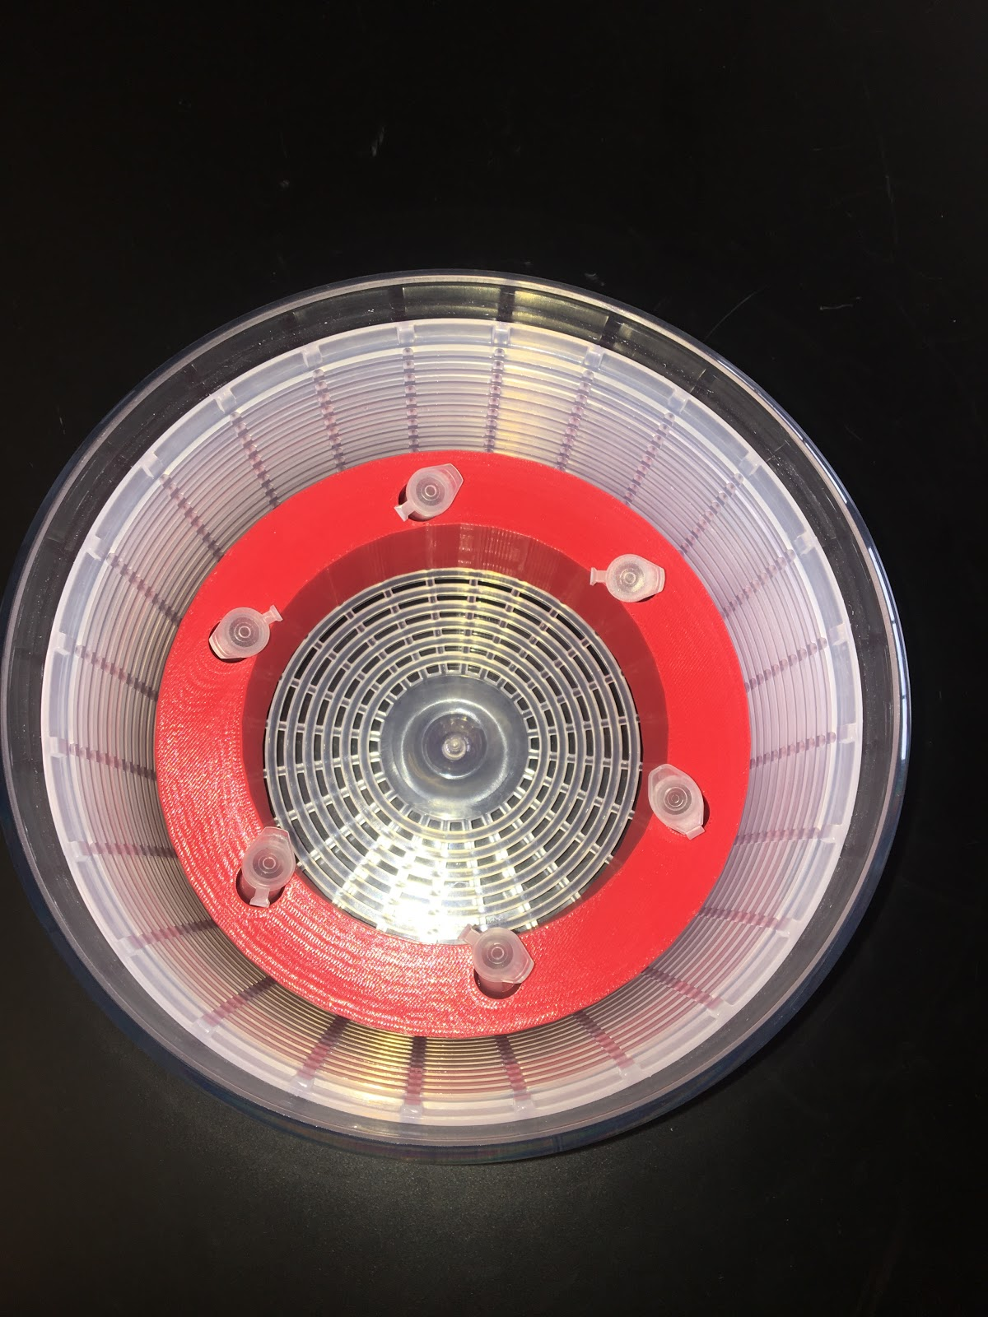
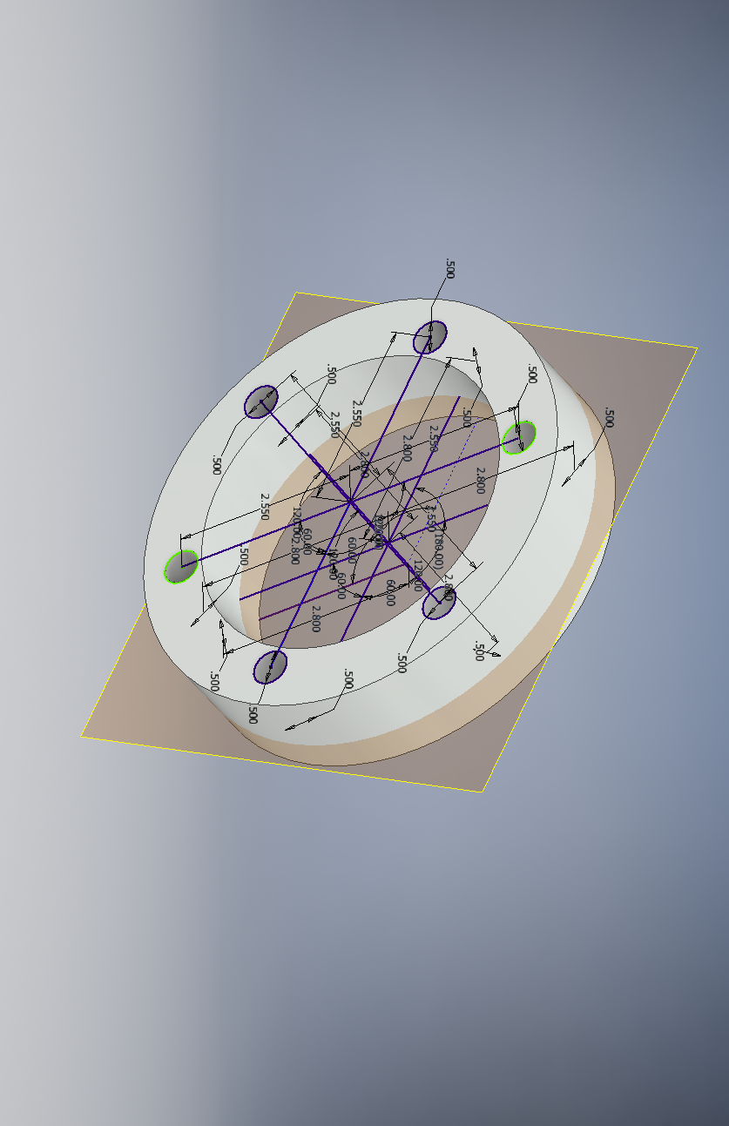
URL
for
More info
Manual Centrifuge
Development of a hand held, manual centrifuge to advance medical treatments and technologies in third world countries
Purpose/Introduction
To advance medical care in third world countries by developing a non-electric centrifuge that is efficient and cost effective for those who are in need.
Design Process and Next Steps
The first design was based off of a hand held pull-string toy, which evolved to a manual flashlight, and finalized as being based off of a salad spinner design. The final design was constructed from a 3D printed insert and preformed well. The next steps in making the centrifuge even more efficient is constructing it to work just as well with less man-power.
Background/Literature review
Although manual centrifuge devices have been constructed in the past, nothing uses the push-spin technology that the innovation utilizes. Most of the similar constructs use a handle and a rotating gear to produce spinning forces.
Results
Electric Centrifuge
Analysis
The data indicated that the design was proficient in the separation of the various parts of blood. This design required more kinetic energy from man-power to have it reach the speed needed to separate. The “centrifuge” function operates as a normal centrifuge would, but requires more strength than an electric powered centrifuge. The liquids that were tested had separate densities to represent blood actually separated when we tested them in our device.
Time Spun | Trial 1 | Trial 2
1 Minute | No Separation | No Separation
10 Minutes | 1.2 mm of separation | 1.4 mm of separation
20 Minutes | 2 mm of separation | 2 mm of separation
Methodology
To create this device, many prototypes were designed to make the most efficient product to achieve the goal. This included a density test to figure out how to mimic the separation of blood. Olive oil, rubbing alcohol, and colored water were used to represent the viscosity of the blood. The test was conducted on both the manual and electric centrifuge for 1 minute, 10 minutes, and 20 minutes to compare the separation.
Manual Centrifuge
Time Spun | Trial 1 | Trial 2
1 Minute | No Separation | No Separation
10 Minutes | 0.9 mm of separation | 1.1 mm of separation
20 Minutes | 1.7 mm of separation | 1.8 mm of separation
Acknowledgements
We would like the thank Mr. Thielke, Mr. Cengia and Mrs. Egan for helping guide us through this whole process.
References
Hays, J. (2012, January). HEALTH CARE IN THE DEVELOPING WORLD (THIRD WORLD). Retrieved December 07, 2017, from http://factsanddetails.com/world/cat57/sub381/item2154.html
,Phan, S. (2016, August 22). Bike-Powered Centrifuge for Developing Countries. Retrieved December 07, 2017, from http://www.borgenmagazine.com/bike-powered-centrifuge-developing-countries/
,Richards-Kortum, R. (2012). Hand-powered centrifuge[A paper describing how the centrifuge works without power and who it is helping.].
Northglenn HS STEM 601 W. 100th Place Northglenn, CO 80260
Monae Guillory Jaide Bucher Brandon Kassel

