Slide 1
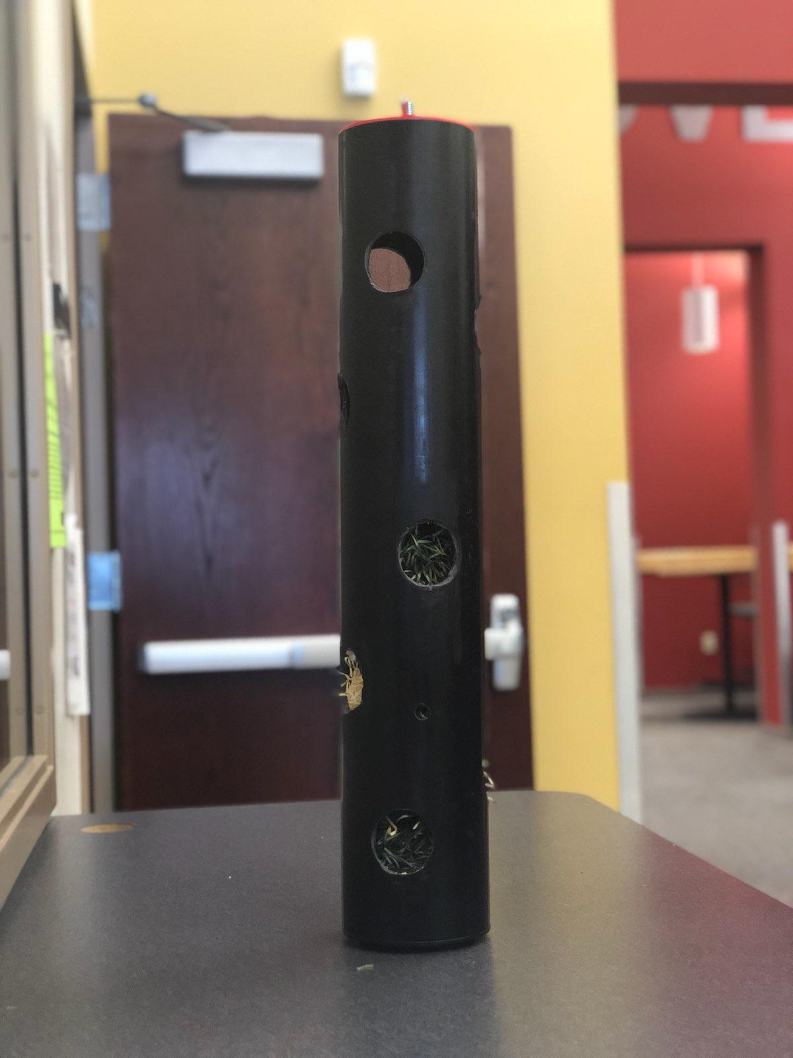
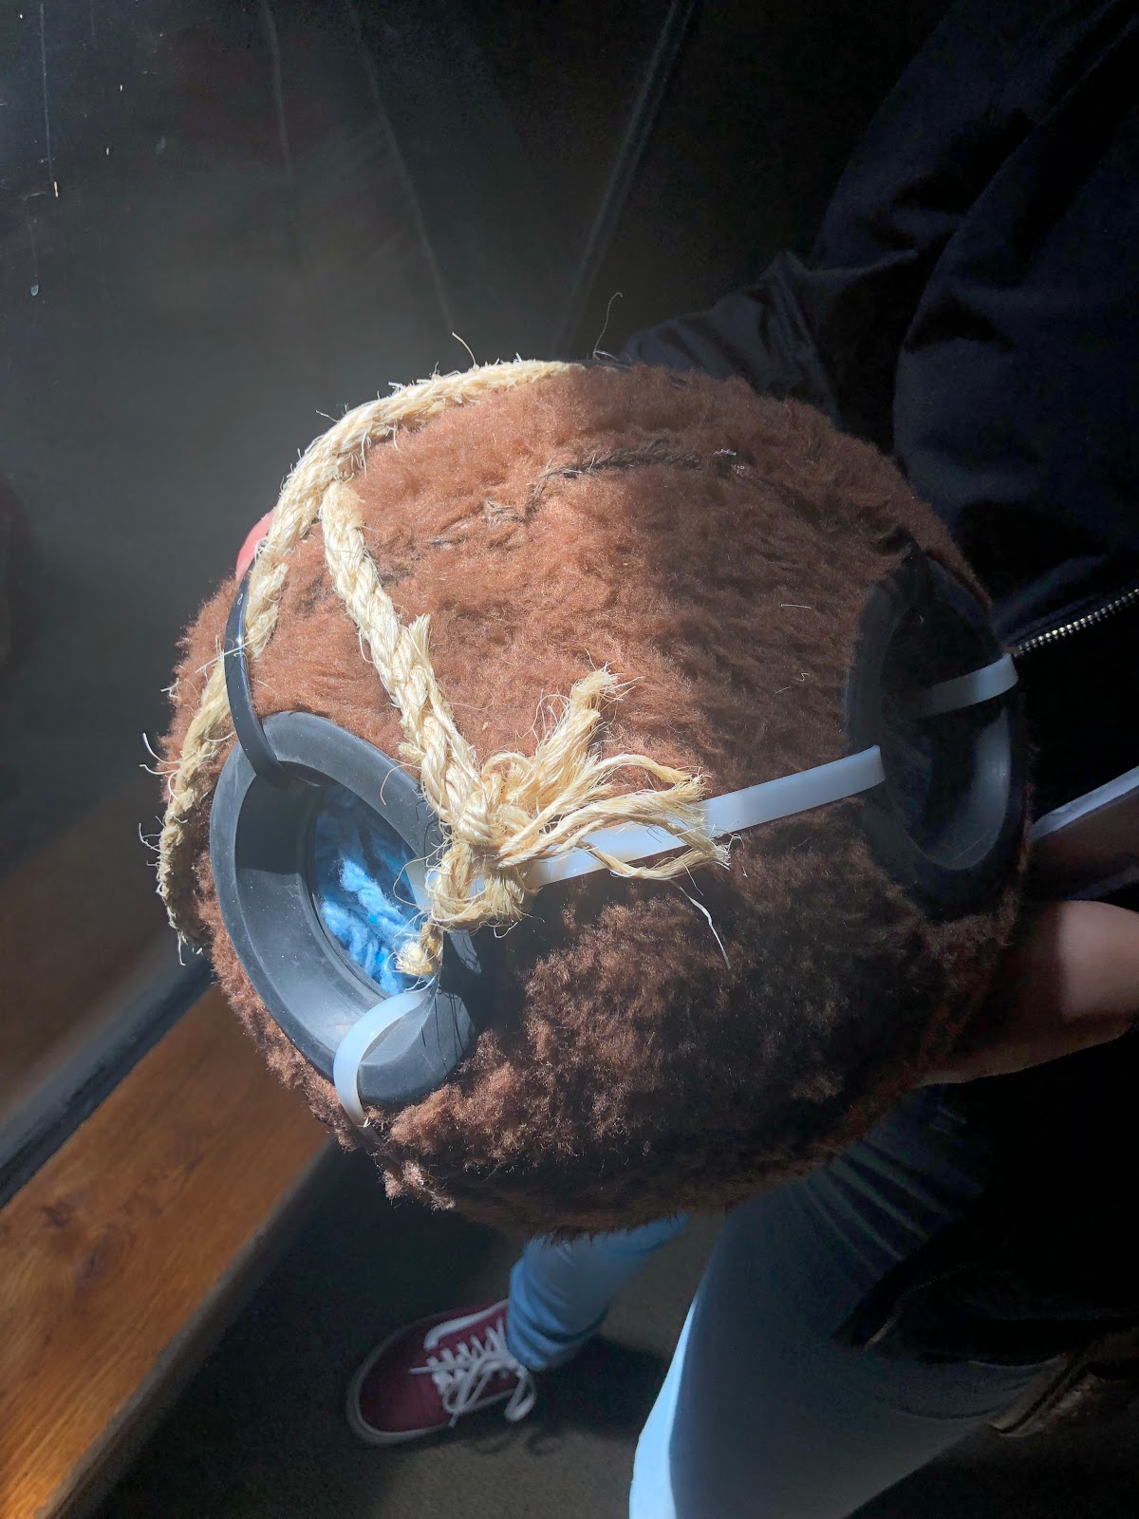
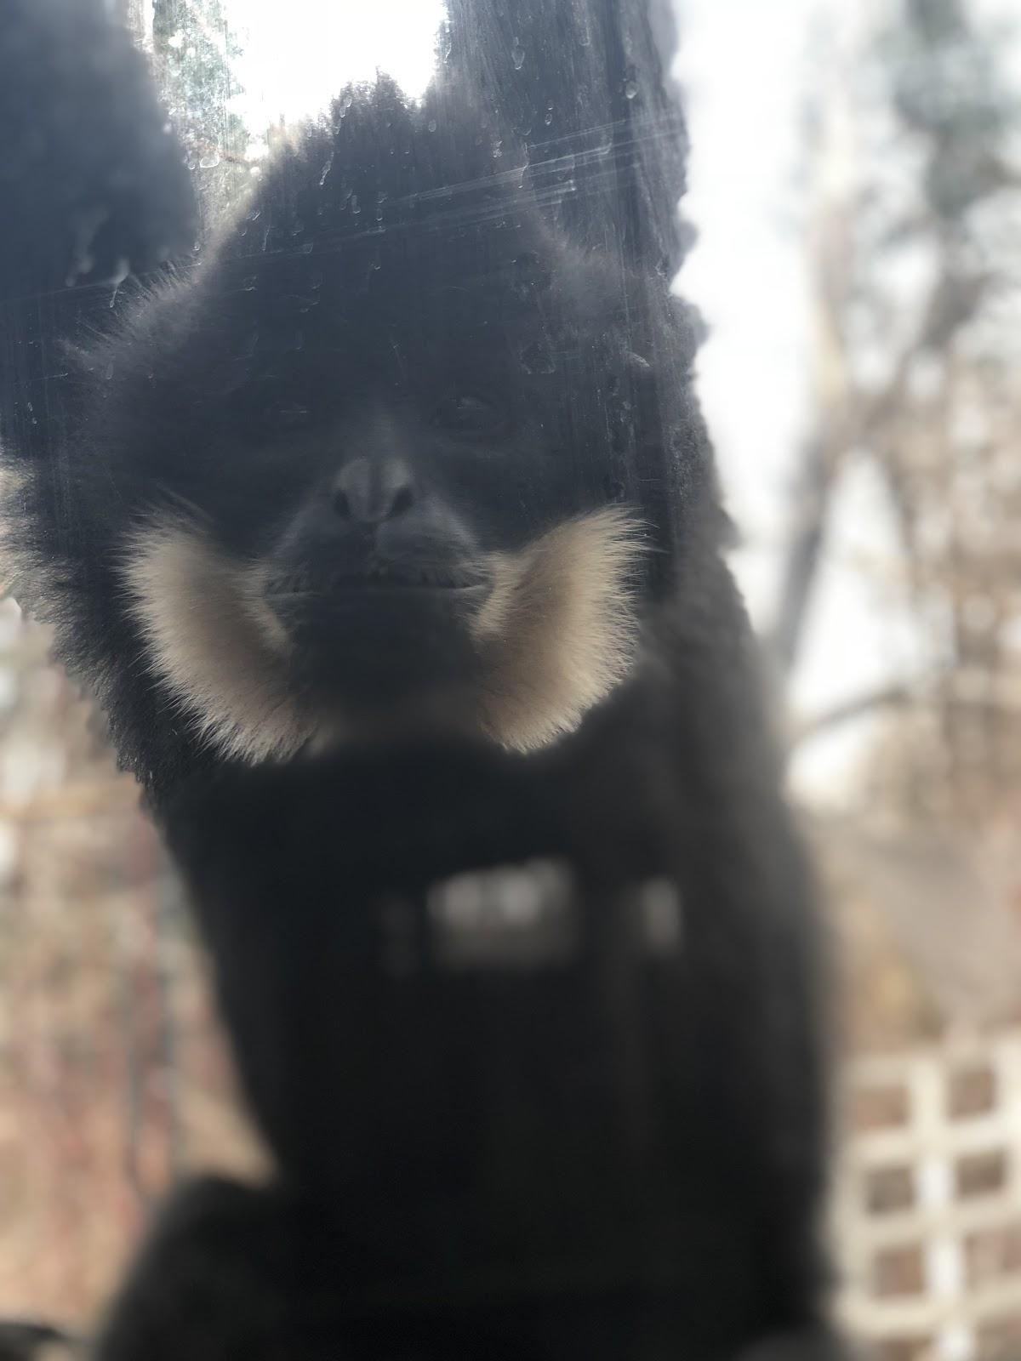
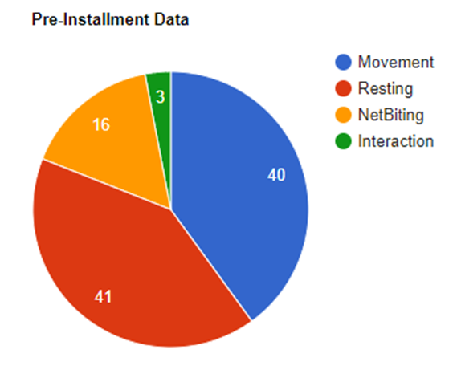
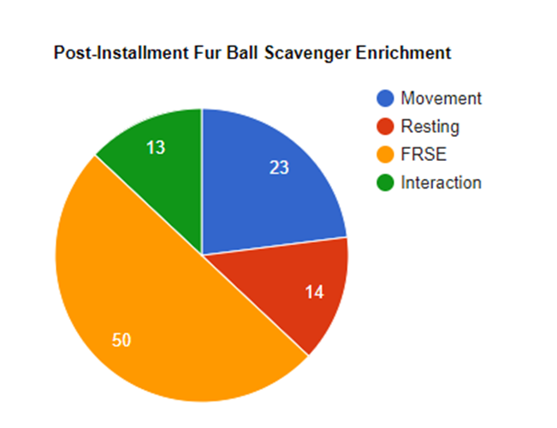
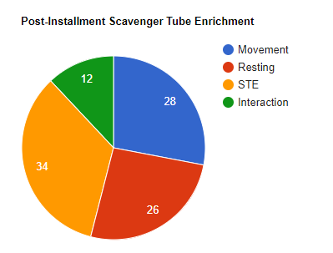
The Effects of Enrichment Devices on Nomascus gabriella behavior at the Denver Zoo
ABSTRACT
The Denver Zoo’s and Northglenn High School’s partnership purpose was to design an enrichment for Leo, the Red Cheeked Gibbon. Leo exhibits stereotypic behavior such as thumb sucking and chewing the fence around his enclosure. The team's task was to build an enrichment to successfully increase grooming and a decrease stereotypical behavior.
PROBLEM STATEMENT
Leo has a number of issues the team is looking to correct with the Scavenger Enrichment. These issues include stereotypic behavior like thumb sucking and chewing on the fence. Stereotypic behavior is repetitive behaviors which an animal would not normally be doing in its natural habitat and appear to have no obvious goal. The undesired behaviors include repetitive pacing, swaying, and bar-biting. The zoo also wants him to be more social and playful in his own enclosure. The overall goal is for the enrichment to provide a synthetic environment for Leo that will help in making him feel not as alone in his enclosure as he is when no enrichment device is at his disposal.
RESULTS
The product produced successful results. The grooming simulator had not only caught the attention of the Gibbon but while he was interacting with it Leo did not exhibit the undesired stereotypical behavior, even in the presence of guests. The team collected data three different times for a period of ten minutes. The time Leo spent resting in the Pre-installed data decreased when compared to the post installment data. The time he spent biting the netting decreased from 16% to 0%. As seen below in the post-installment data of the Fur Ball Scavenger Enrichment and the post-installment data of the Tube scavenger enrichment, they were successful. Leo spent 50% of the time interacting with the ball and 34% interacting with the tube.
BACKGROUND
Leo, a full grown 12 year-old male Nomascus gabriellae, has lived his whole life at the Denver Zoo. Leo currently lives by himself and he has four missing fingers on his right hand. He spends little to no time on the ground and is constantly swinging around his enclosure. He is very vocal and people can hear his “spectacular singing calls” throughout the zoo. He is very active and loves getting attention from guests. He constantly shows stereotypic behavior and is isolated. He is in his enclosure alone and needs some sort of interaction within his enclosure.
METHODOLOGY
Problem is given by Denver Zoo
Brainstorm and planning begin
Solution is proposed and building begins
Pre-installment data is collected
First initial Enrichment is tested (Post Installment Tube Enrichment Data)
Enrichment is improved
Final enrichment design is built and tested
CONCLUSION
The Scavenger Enrichments, both the tube and the ball design overall showed significant improvement in Leo’s activity. Stereotypic behavior in Leo has decreased. By implementing the enrichment, there was a change in the subject’s environment, and enhanced Leo’s natural tendencies such as foraging and looking for food. Overall, the team’s goal was reached which was to synthetically create an environment around him that will recreate a natural habitat. With the exclusion of the increased time Leo spent interacting with the Zoo Guests.
Design Process
The initial design was to have a hanging, holed, hollow sphere containing a straw material as well as food and insects that Leo, the Nomascus gabriellae could scavenge for. As the team met up with the group’s mentors, they provided the team with key recommendations. However, most of the recommendations were regarding the weaved fabric enrichment. This gave the members working on the ball enrichment to have a broad take on it since the mentors didn't have a problem with the design. The final proposed design was based on combining multiple aspects of the initial designs. The team brainstormed and had a prototype for a sphere shaped enrichment. However, due to technical difficulties and lack of resources this was changed to a tube- shaped enrichment. However, after plenty of research the team was able to create the ball enrichment that was the desired design.
Work Cited
N/A. 4 Food Based Enrichment. Jan. 2015, projectorangutan.com/wp-content/uploads/2015/01/Enrichment-catalogue-4-Food-Based-Enrichment.pdf+. Accessed 4 Dec. 2017.
The Editors of Encyclpedia Britannica. (2017, April 24). Gibbon. Retrieved December 7, 2017, from https://www.britannica.com/animal/gibbon-primate
“Gibbons.” National Geographic, Nat Geo, 8 Nov. 2010, www.nationalgeographic.com/animals/mammals/group/gibbons/.
“Our Primates In The Wild.” Endangered Asian Species Trust, www.go-east.org/pages/golden-cheeked-gibbons.html.
Fact sheet: Yellow-Cheeked crested gibbon, Nomascus gabriellae, Thomas Geissmann Anthropological Instiute, www.gibbons.de/main2/08teachtext/factgabriellae/gabriellaefact.html.
ACKNOWLEDGMENTS
Jacqueline Rundquist, Denver Zookeeper; Amy Lear, Middle and High School Programs Coordinator; Tom Schermerhorn, Middle and High School Programs Denver Zoo
Northglenn HS STEM 601 W. 100th Place Northglenn, CO 80260
Paola Rivera, Cameron Quade, Thalia Guzman

