Slide 1
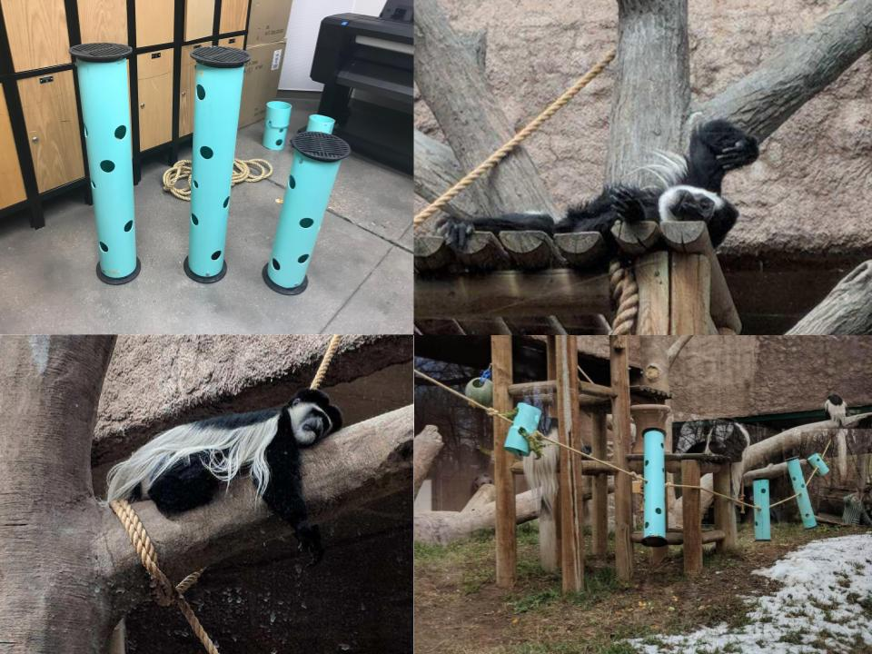
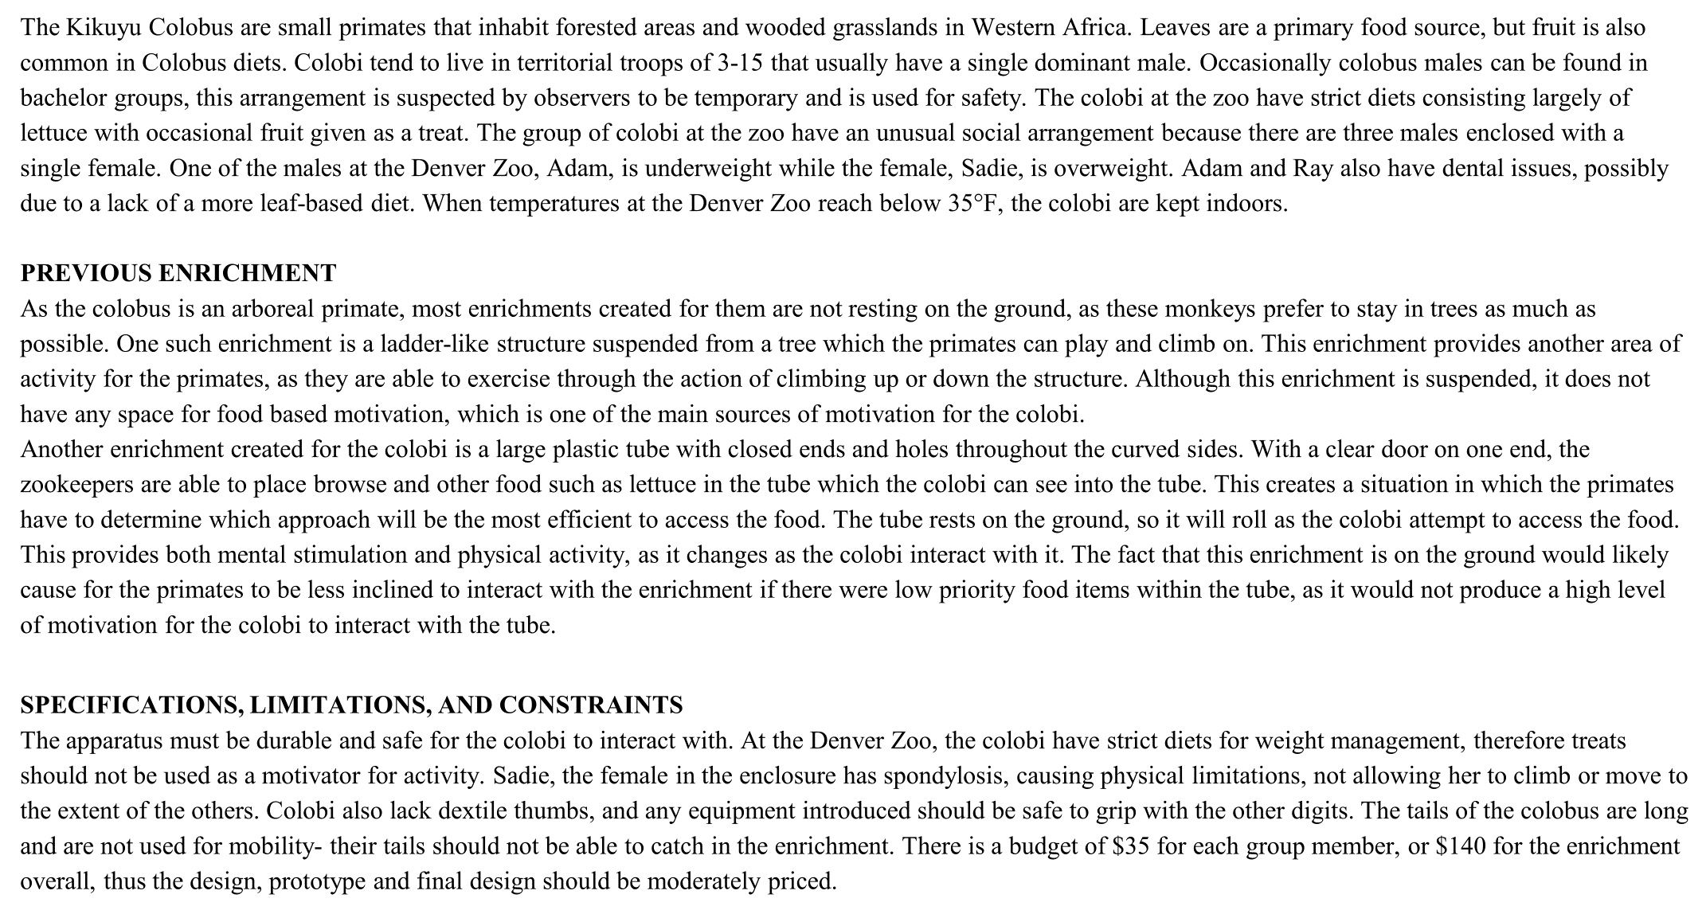
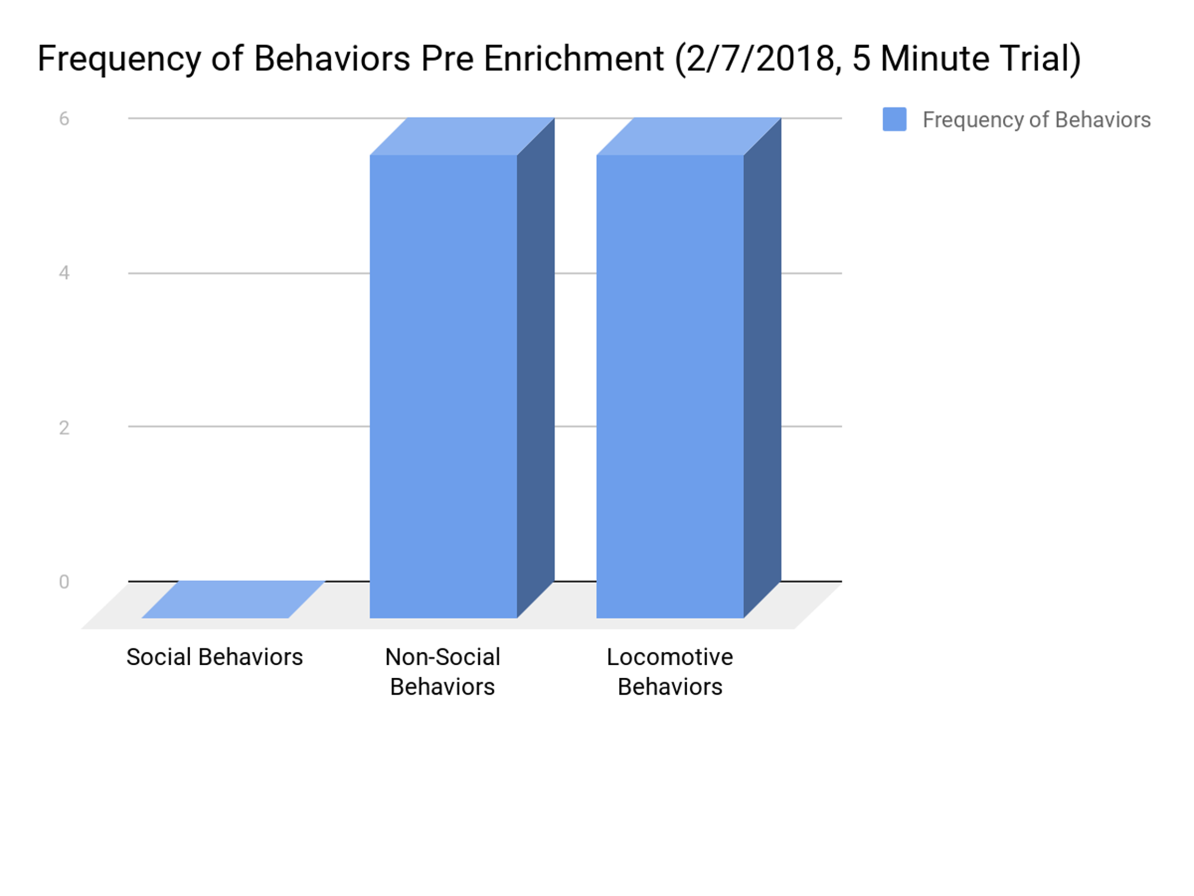
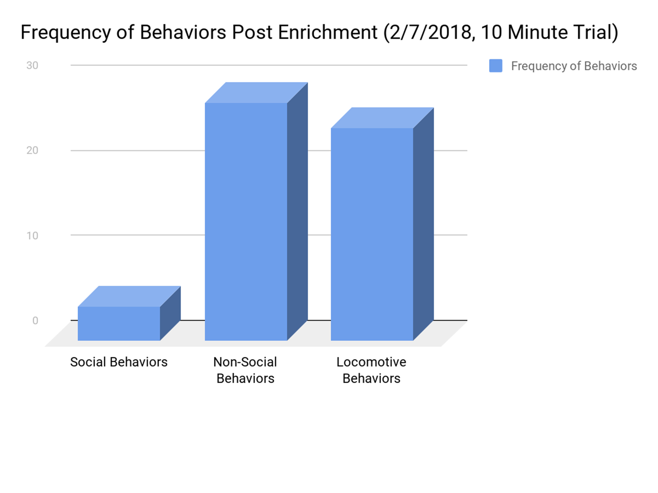
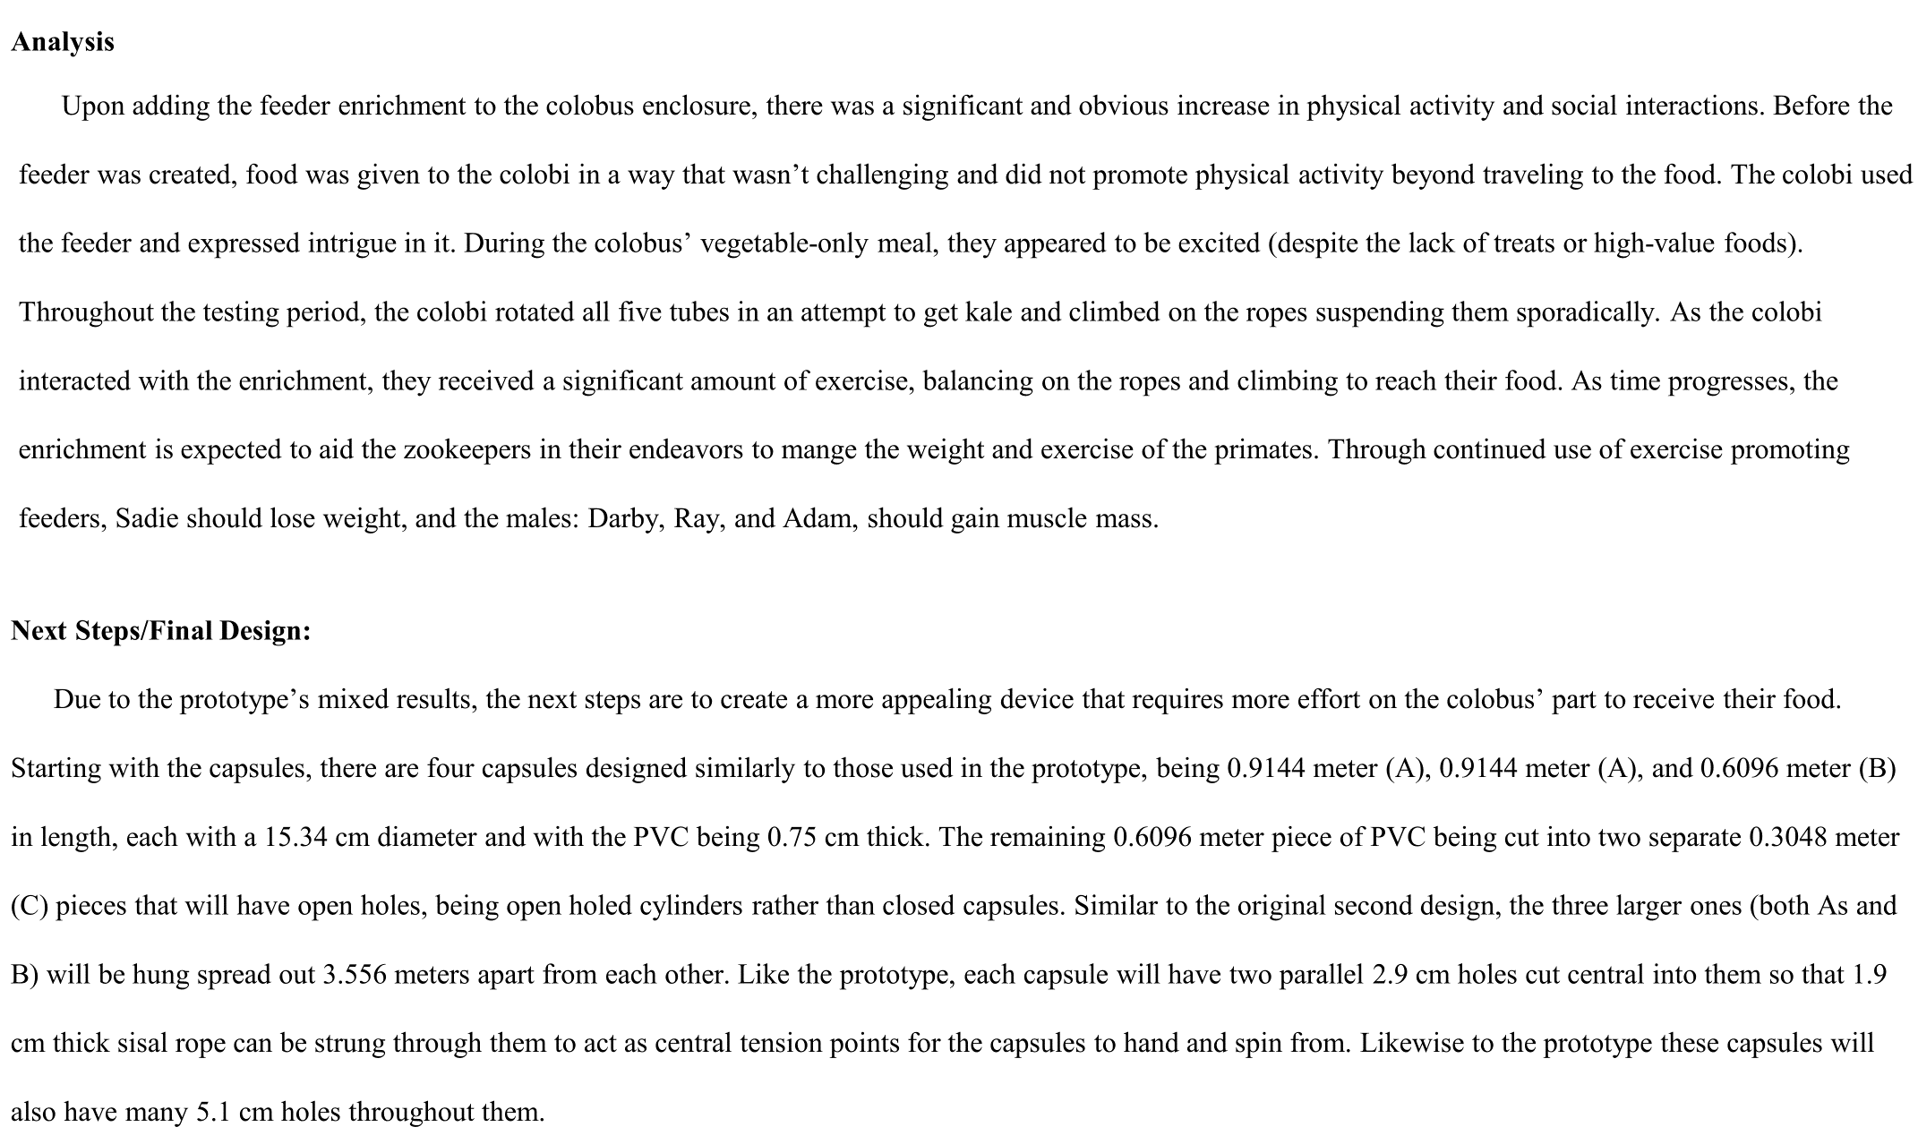
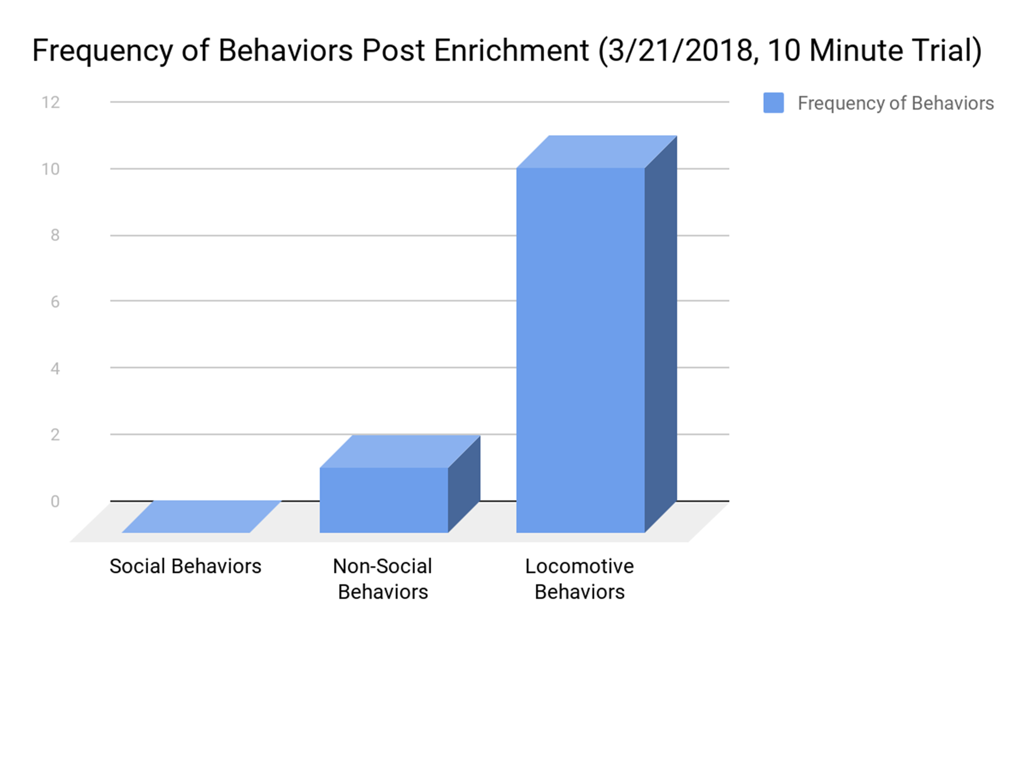
Kikuyu Black and White Colobus
URL
for
More info
Can the weight of colobus be maintained with the use of an exercise promoting enrichment?
Purpose/Introduction
Design Process
Prototype
Wireframe
Picures
Background/Literature Review
Results and Conclusion
Pre-Enrichment
Prototype
Analysis and Next Steps
Final
Acknowledgements
Northglenn HS STEM 601 W. 100th Place Northglenn, CO 80260
Chandler Sanchez, Brenna Ramm, Natalie Mata, Tiffany Deeds
Notes:
Switch design process and analysis

Slide 2
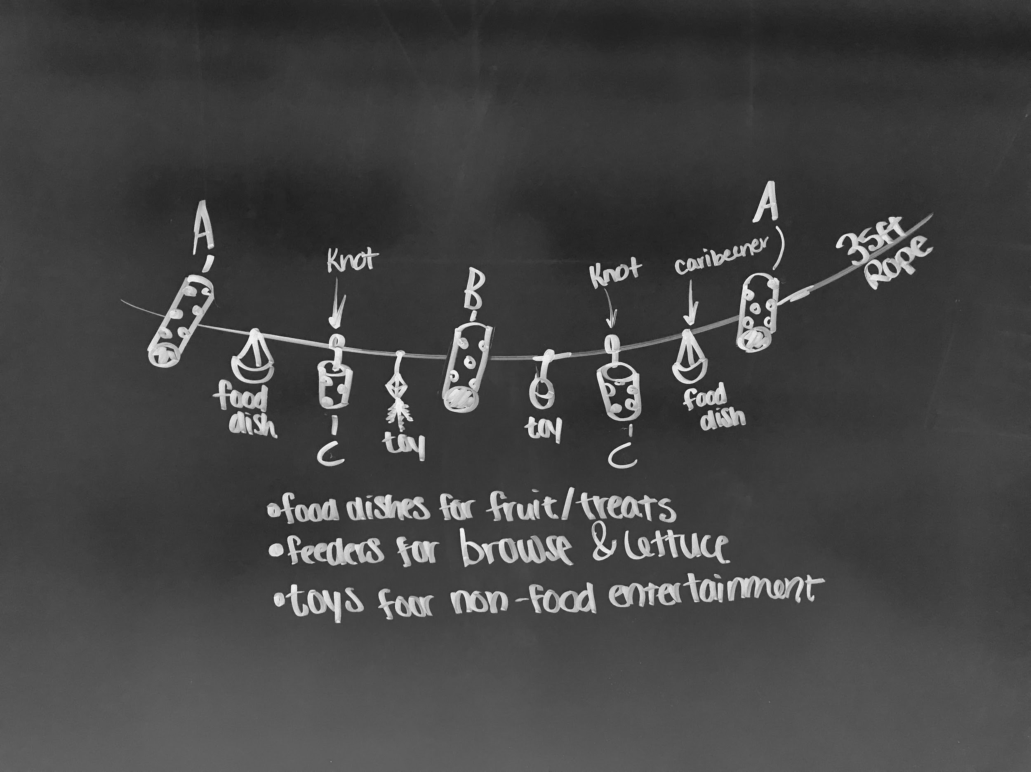
Prototype Wireframe Picture

Slide 3
Intro/Purpose
Every year, Northglenn High School’s Biomedical STEM seniors embark on a capstone project in which they attempt to create a testable device that solves a medical problem, occasionally pairing with the Denver Zoo to enrich the lives of the animals. This year a major problem was that their Kikuyu black and white Colobus (small primates) were having issues with weight and activity. One of the male black and white colobus (Adam) is underweight, while the female colobus (Sadie) is overweight. When observed, the colobus remained fairly stationary, moving only occasionally when provoked by each other or in search for food. In order to improve their weights, they will all need to undergo more daily physical activity. Through the implementation of an enrichment apparatus, the colobus at the Denver Zoo will have increased exercise, while having more options for enrichment, socialization, and engagement, simultaneously treating weight imbalances and entertaining the animals.

Slide 4
Background/Literature Review
The Kikuyu Colobus are small primates that inhabit forested areas and wooded grasslands in Western Africa. Leaves are a primary food source, but fruit is also common in Colobus diets. Colobi tend to live in territorial troops of 3-15 that usually have a single dominant male. Occasionally colobus males can be found in bachelor groups, this arrangement is suspected by observers to be temporary and is used for safety. The colobi at the zoo have strict diets consisting largely of lettuce with occasional fruit given as a treat. The group of colobi at the zoo have an unusual social arrangement because there are three males enclosed with a single female. One of the males at the Denver Zoo, Adam, is underweight while the female, Sadie, is overweight. Adam and Ray also have dental issues, possibly due to a lack of a more leaf-based diet. When temperatures at the Denver Zoo reach below 35°F, the colobi are kept indoors. PREVIOUS ENRICHMENT As the colobus is an arboreal primate, most enrichments created for them are not resting on the ground, as these monkeys prefer to stay in trees as much as possible. One such enrichment is a ladder-like structure suspended from a tree which the primates can play and climb on. This enrichment provides another area of activity for the primates, as they are able to exercise through the action of climbing up or down the structure. Although this enrichment is suspended, it does not have any space for food based motivation, which is one of the main sources of motivation for the colobi. Another enrichment created for the colobi is a large plastic tube with closed ends and holes throughout the curved sides. With a clear door on one end, the zookeepers are able to place browse and other food such as lettuce in the tube which the colobi can see into the tube. This creates a situation in which the primates have to determine which approach will be the most efficient to access the food. The tube rests on the ground, so it will roll as the colobi attempt to access the food. This provides both mental stimulation and physical activity, as it changes as the colobi interact with it. The fact that this enrichment is on the ground would likely cause for the primates to be less inclined to interact with the enrichment if there were low priority food items within the tube, as it would not produce a high level of motivation for the colobi to interact with the tube.
SPECIFICATIONS, LIMITATIONS, AND CONSTRAINTS The apparatus must be durable and safe for the colobi to interact with. At the Denver Zoo, the colobi have strict diets for weight management, therefore treats should not be used as a motivator for activity. Sadie, the female in the enclosure has spondylosis, causing physical limitations, not allowing her to climb or move to the extent of the others. Colobi also lack dextile thumbs, and any equipment introduced should be safe to grip with the other digits. The tails of the colobus are long and are not used for mobility- their tails should not be able to catch in the enrichment. There is a budget of $35 for each group member, or $140 for the enrichment overall, thus the design, prototype and final design should be moderately priced.

Slide 5
Methodology
Observations of the colobi were taken primarily using duration collection, which is a comparison of time engaged to time not engaged. In a set period of time, a stopwatch was started each time the colobus being examined was engaged in physical activity. Physical activity is defined as any of the following:
BEHAVIOR | CODE | DEFINITION
Climbing | CL | Climbing up or down any structure
Walking | WA | Moving from one place to another
Hanging | HA | Suspension from hands or feet from a structure
Jumping | JU | Leaping from one structure or area to another
Toy Interaction | TI | Playing with an enrichment
Eating | EA | Does not include occasions when colobus are eating while stationary
Fighting | F | Play or aggressive interaction between two or more colobus
Notes:
Explain duration collection

Slide 6
Analysis
The prototype consists of three separate capsules linked together with a sturdy yet removable rope. The three capsules of various size (~21.5 cm in diameter and 32.5 cm, 51.5 cm, and 56 cm in length respectively) were composed of a thick cardboard tubing (provided by the school). Each capsule has varying large holes (5.1 cm diameter) sawed into the sides. Through the center of each capsule 2.9 cm holes were cut and thick sisal rope was looped throughout the collect each capsule, with overhand knots used to separate all three capsules. The ends were bowline hitched to two heavy duty twist lock carabineers which could be used for safe and easy attachment throughout the enclosures. 3D designs for an ABS plastic cap and hinges were drafted in the programing application Inventor, however due to time constraints they weren’t printed and implemented into the prototype.

Slide 7
Analysis
Upon adding the feeder enrichment to the colobus enclosure, there was a significant and obvious increase in physical activity and social interactions. Before the feeder was created, food was given to the colobi in a way that wasn’t challenging and did not promote physical activity beyond traveling to the food. The colobi used the feeder and expressed intrigue in it. During the colobus’ vegetable-only meal, they appeared to be excited (despite the lack of treats or high-value foods). Throughout the testing period, the colobi rotated all five tubes in an attempt to get kale and climbed on the ropes suspending them sporadically. As the colobi interacted with the enrichment, they received a significant amount of exercise, balancing on the ropes and climbing to reach their food. As time progresses, the enrichment is expected to aid the zookeepers in their endeavors to mange the weight and exercise of the primates. Through continued use of exercise promoting feeders, Sadie should lose weight, and the males: Darby, Ray, and Adam, should gain muscle mass.
Next Steps/Final Design:
Due to the prototype’s mixed results, the next steps are to create a more appealing device that requires more effort on the colobus’ part to receive their food. Starting with the capsules, there are four capsules designed similarly to those used in the prototype, being 0.9144 meter (A), 0.9144 meter (A), and 0.6096 meter (B) in length, each with a 15.34 cm diameter and with the PVC being 0.75 cm thick. The remaining 0.6096 meter piece of PVC being cut into two separate 0.3048 meter (C) pieces that will have open holes, being open holed cylinders rather than closed capsules. Similar to the original second design, the three larger ones (both As and B) will be hung spread out 3.556 meters apart from each other. Like the prototype, each capsule will have two parallel 2.9 cm holes cut central into them so that 1.9 cm thick sisal rope can be strung through them to act as central tension points for the capsules to hand and spin from. Likewise to the prototype these capsules will also have many 5.1 cm holes throughout them.

Slide 8
Results
The colobus increased their locomotive movements with the enrichment compared to without the enrichment (6 locomotive movements in the first five minutes without the enrichment compared to 15 locomotive movements in the first five minutes with the enrichment) the ratio between non-social behavior and locomotive and social behavior went from 1:1 to 28:27 respectively.

Slide 9
Time | Social Behavior | Non-Social Behavior | Locomotive Behavior
0:00 - 0:30
0:30 - 1:00 |  | E (s****) | PA (s)
1:00 - 1:30
1:30 - 2:00
2:00 - 2:30 |  | C (s), E (a***) | CR (s,a)
2:30 - 3:00
3:00 - 3:30
3:30 - 4:00
4:00 - 4:30
4:30 - 5:00 |  |  | PA (d**), Ro (d)
5:00 - 5:30 |  | E (a) | CR (a)
5:30 - 6:00 |  |  | Ro (r*)
6:00 - 6:30
6:30 - 7:00
7:00 - 7:30
7:30 - 8:00 |  | E (a) | H (a), PA (r)
8:00 - 8:30
8:30 - 9:00
9:00 - 9:30
9:30 - 10:00 |  | L (R)
10:00 - 10:30
10:30 - 11:00 |  |  | PA (a)
11:00 - 11:30
11:30 - 12:00
12:00 - 12:30 |  |  | CR (r)
12:30 - 13:00 |  |  | CR (a)
Time | Social Behavior | Non-Social Behavior | Locomotive Behavior
0:00 - 0:30 |  | E (r*) | J (r,d**), C(r), PA (r)
0:30 - 1:00 |  | E (r,d) | J (d), CR (d), PA (r)
1:00 - 1:30 |  | E (r,d) | C (a***)
1:30 - 2:00 |  | E (r,d)
2:00 - 2:30 |  | E (r,d) | PA (r)
2:30 - 3:00 |  | E (r,d)
3:00 - 3:30 |  | E (r,d) | C (a)
3:30 - 4:00 | PS (r, a) | E (r,d) | J (r, a), C (r), PA (r)
4:00 - 4:30 |  | E (r)
4:30 - 5:00 |  | E (r) | J (a)
5:00 - 5:30 |  |  | C (a)
5:30 - 6:00 | F (a, d) | H (a) | PA (a), C (a), J(d), CR (d)
6:00 - 6:30 |  | H (a), E (a, d)
6:30 - 7:00 |  | E (d)
7:00 - 7:30 |  | E (a), L (a) | J (a)
7:30 - 8:00 |  | L (a)
8:00 - 8:30 |  | E (d) | J (d)
8:30 - 9:00 |  |  | CR (a), J (a)
9:00 - 9:30 |  | L (d) | C (a)
9:30 - 10:00 |  | L (a)
Total | 4 | 28 | 25

Slide 10
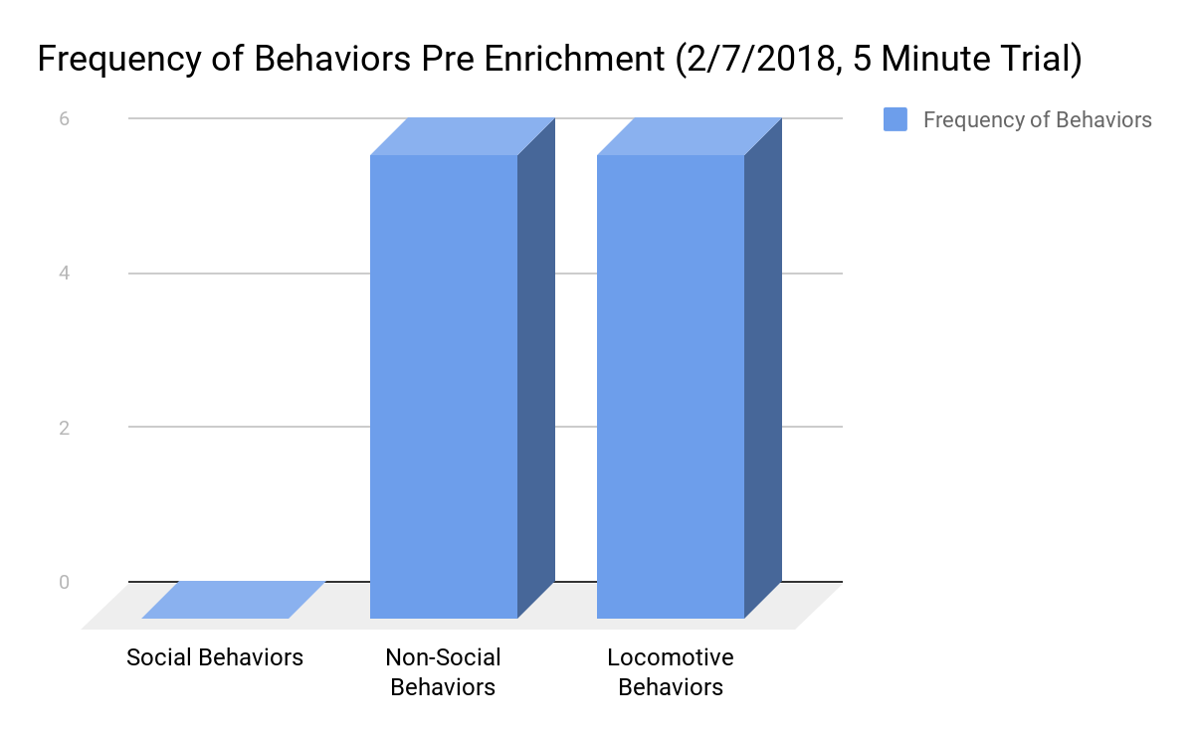

Slide 11
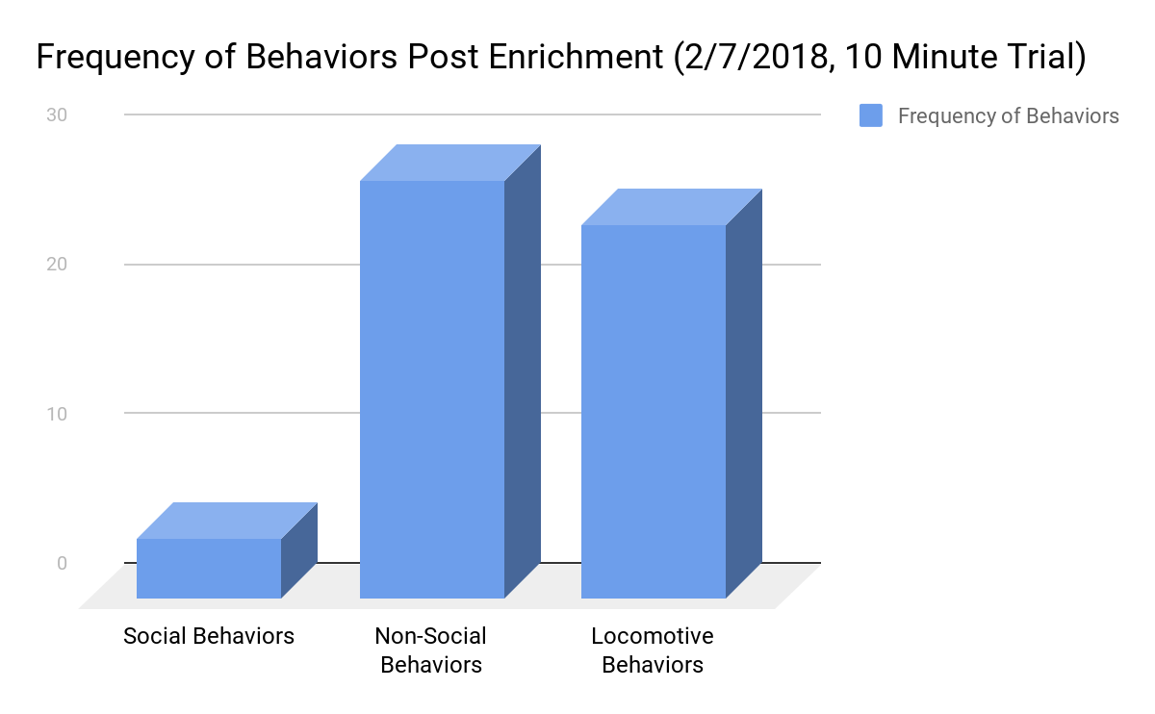

Slide 12
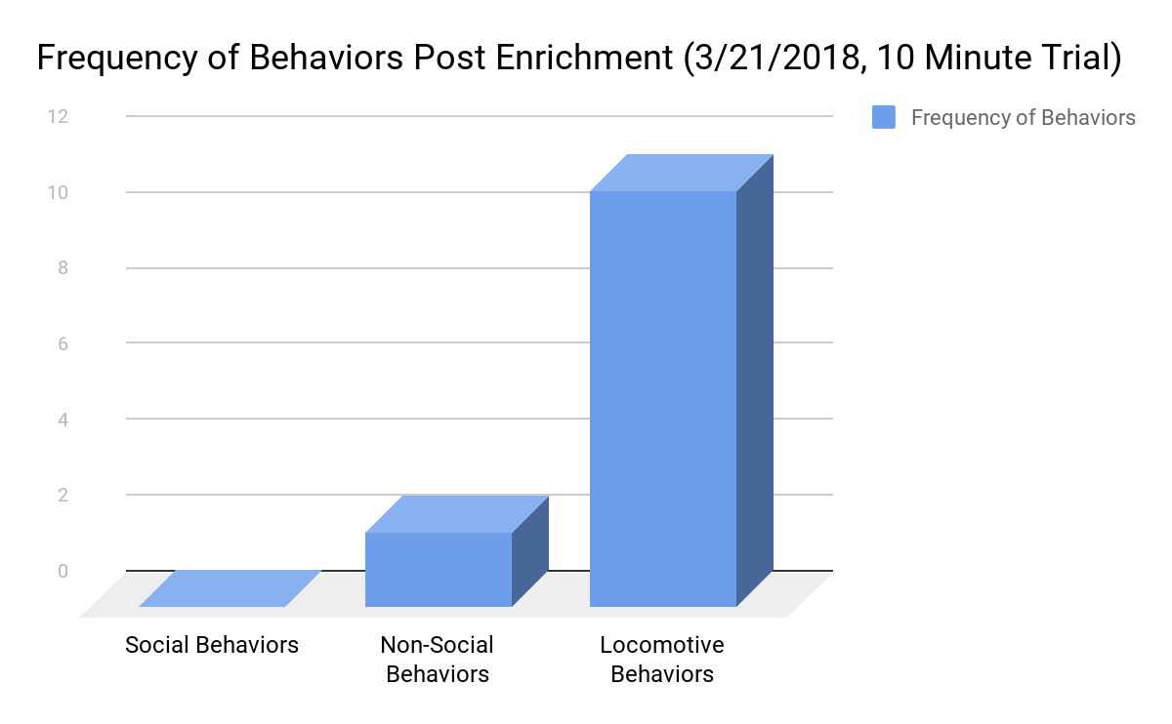

Slide 13
Throughout the testing period, the colobus rotated all five tubes in an attempt to get kale and climbed on the ropes, suspending them sporadically. As the colobus interacted with the enrichment, they received a significant amount of exercise, balancing on the ropes and climbing to reach their food. As time progresses, the enrichment is expected to aid the zookeepers in their endeavors to manage the weight and exercise of the primates. Through continued use of exercise promoting feeders, Sadie should lose weight, and the males: Darby, Ray, and Adam, should gain muscle mass.

Slide 14
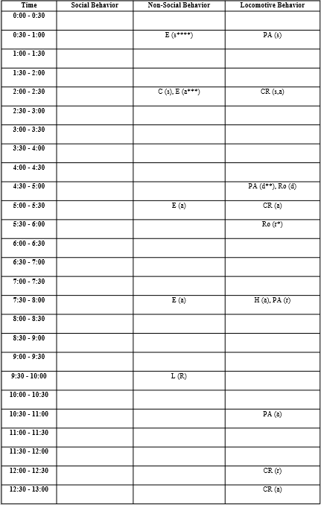

Slide 15
The Denver Zoo, William Thielke, Michael Cengia
BACKGROUND
Delson E. 1994. Evolutionary history of the colobine monkeys in paleoenvironmental perspective. In: Oates JF, Davies AG (eds). Colobine Monkeys: their ecology, behaviour and evolution. 11-43. Cambridge University Press, UK
Kim, K. 2002. "Colobus guereza" (On-line), Animal Diversity Web. Accessed December 05, 2017 at http://animaldiversity.org/accounts/Colobus_guereza/
Los Angleles Zoo and Botanical Gardens (Ed.). (2017). Monkey, Kikuyu Colobus. Retrieved November 21, 2017, from http://www.lazoo.org/animals/mammals/kikuyu-colobus-monkey/
Wasserman M. D., Chapman C. A. 2003. Determinants of colobins monkey abundance: the importance of food energy, protein and fibre content. Journal of Animal Ecology 72: 650-659
PAST DEVICES
Burgess, A. (n.d.). Suggested Guidelines for Primate Enrichment (F. Dunker, M. Griffin, & S. Barker, Eds.). Retrieved November 21, 2017, from https://www.aazk.org/wp-content/uploads/Suggested-Guidelines-for-Primate-Enrichment.pdf
O’ Dwyer, R. (2011). The black-and-white colobus monkeys (Colobus angolensis palliatus) of Diani forest, Kenya. Retrieved November 24, 2017, from https://stud.epsilon.slu.se/5150/7/Odwyer_R_121221.pdf

Slide 16
Resources
BACKGROUND
Delson E. 1994. Evolutionary history of the colobine monkeys in paleoenvironmental perspective. In: Oates JF, Davies AG (eds). Colobine Monkeys: their ecology, behaviour and evolution. 11-43. Cambridge University Press, UK
Fimbel C., Vedder A., Dierenfeld E., Mulindahabi F. 2001. An ecological basis for large group size in Colobus angolensis in the Nyungwe forest, Rwanda. African Journal of Ecology 39: 83-92
Huffman, E. (n.d.). Colobus Monkey. Retrieved November 26, 2017, from http://itech.fgcu.edu/faculty/sstans/colohuff.html
Kim, K. 2002. "Colobus guereza" (On-line), Animal Diversity Web. Accessed December 05, 2017 at http://animaldiversity.org/accounts/Colobus_guereza/
Los Angleles Zoo and Botanical Gardens (Ed.). (2017). Monkey, Kikuyu Colobus. Retrieved November 21, 2017, from http://www.lazoo.org/animals/mammals/kikuyu-colobus-monkey/
Wasserman M. D., Chapman C. A. 2003. Determinants of colobins monkey abundance: the importance of food energy, protein and fibre content. Journal of Animal Ecology 72: 650-659
PAST DEVICES
Burgess, A. (n.d.). Suggested Guidelines for Primate Enrichment (F. Dunker, M. Griffin, & S. Barker, Eds.). Retrieved November 21, 2017, from https://www.aazk.org/wp-content/uploads/Suggested-Guidelines-for-Primate-Enrichment.pdf
O’ Dwyer, R. (2011). The black-and-white colobus monkeys (Colobus angolensis palliatus) of Diani forest, Kenya. Retrieved November 24, 2017, from https://stud.epsilon.slu.se/5150/7/Odwyer_R_121221.pdf
“Wood Perch.” Otto Environmental, Otto Environmental, www.ottoenvironmental.com/wood-perch-3.
/v

