Slide 1
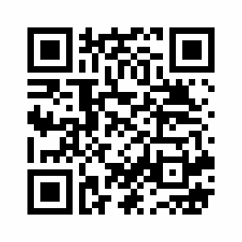
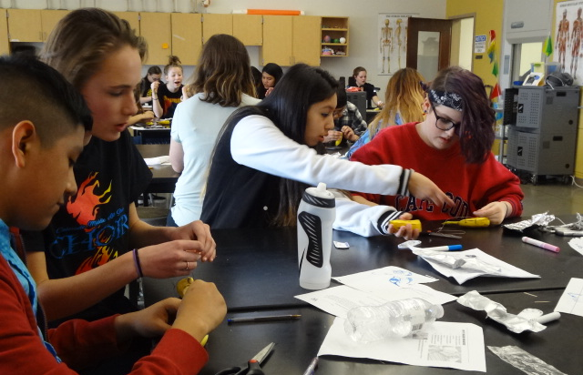
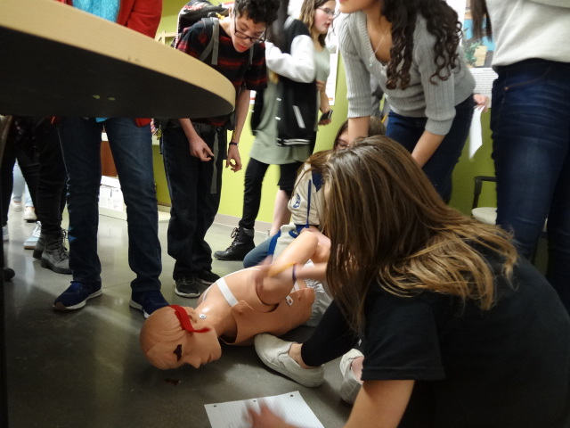
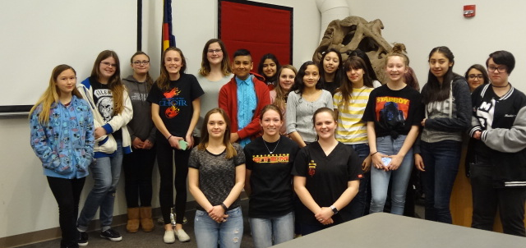
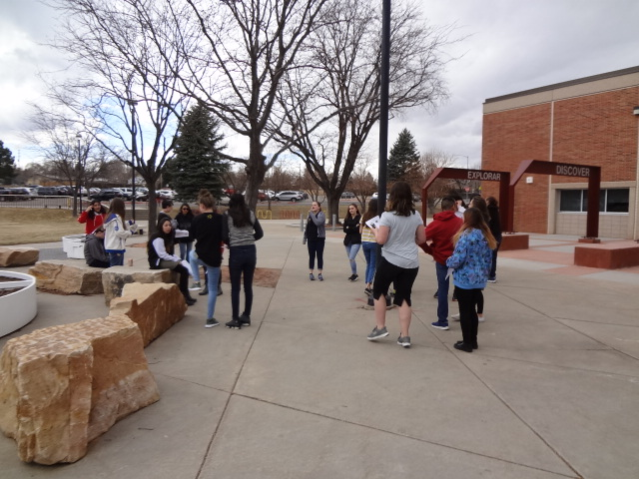
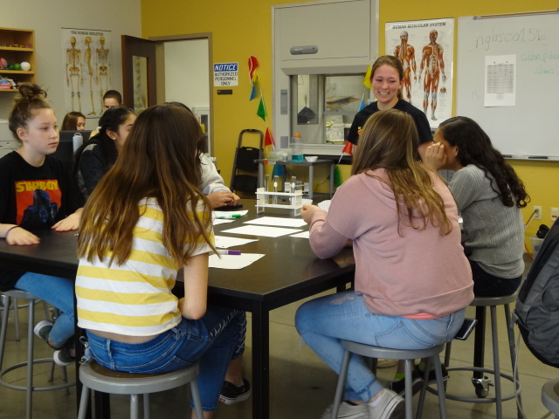
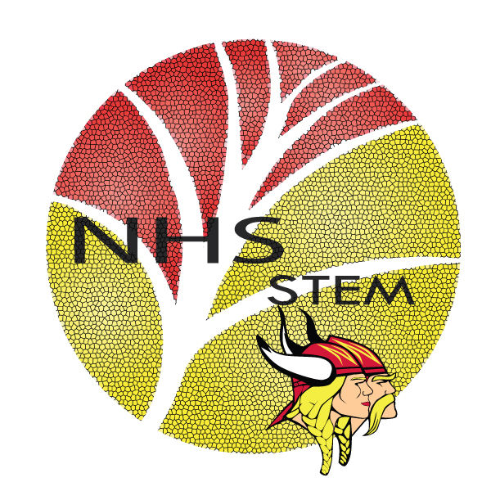
Science Saturday
URL
for
More info
An Introductory Biomedical Sciences Event
Purpose/Introduction
Science Saturday’s sole purpose was to get incoming freshmen involved with the Biomedical Pathway STEM has to offer. The goal was to produce activities that mimic those found throughout the pathway, such as forensic techniques, critical thinking skills, and general biology. The children were able to get a feel for the Biomedical Pathway and allowed us to determine the most receptive teaching style.
Prototype
Wireframe
Pictures
Design Process and Next Steps
Science Saturday was previously directed towards third through seventh graders. As lesson plans were developed, it was concluded that this event would be more impactful if it was directed towards incoming ninth graders who were to be part of the Biomedical Pathway. The final event ended up consisting of one large group who rotated together through four different sessions.
Background/Literature Review
Other programs have been held at Northglenn High School to acclimate incoming 9th graders, such as Camp Ignition. However, this camp focused primarily on the engineering pathway and problem based learning that Northglenn has to offer. While the activities presented at this event reflect PLTW’s curriculum, they lack emphasis in biomedical sciences. As the biomedical sciences pathway is a large part of STEM at Northglenn High School, the developers felt there should be an event that fairly portrays the activities offered within the pathway.
Results
Upon arrival, students were asked to take a quick pre quiz to test their current knowledge. The average score was 4.8125/11 and served as a control group. After all activities were concluded, students were asked to take a post quiz with the same questions. The average score of the post quiz was 7.0625/11.
Methodology
Science Saturday was held on March 10th of 2018 in the STEM wing of Northglenn High School. The event was held from 12:30 – 4:00 pm. Upon arrival, students took a pre quiz to test their current knowledge and after all were complete, students went to start the first activity, the DNA workshop. Students extracted the DNA of a banana and built a DNA model composed of gummy bears and twizzlers. Directly following this workshop, students participated in a vitals workshop that demonstrated the structure and functionality of the heart. The third workshop taught students about the history of suturing, as well as various techniques. Students were able to practice these techniques on their own by suturing the skin of a banana. The final workshop simulated a criminal investigation in which students identified a suspect and presented their findings. The students took a post test following the last activity.
Analysis and Next Steps
To determine how effective the activities were, students were given both a pre and post quiz that covered topics that were to be taught at the event. Based on the overall increase in score, the event yielded useful, meaningful information to the students. The average score of the post quiz when compared to the pre quiz increased by 2.25 points. When taking into account that the students only worked with the material for ~3 hours, this is a significant increase. In future years, the event can be opened up to a wider range of students, allowing them to be introduced to STEM.
Acknowledgements
The developers would like to give a huge thank you to Lori Egan and William Thielke for helping with logistical planning and coordination. Another huge thanks goes out to HOSA and National Honor Society volunteers for help with set-up and clean-up. Of course, our last thank you goes out to the amazing group of incoming ninth graders who participated, who truly helped make Science Saturday a worthwhile event.
References
Bureau of Labor Statistics. (n.d.). 2016 Median Pay. Retrieved December 07, 2017, from https://www.bls.gov/ooh/healthcare/home.htm
Colorado Department of Education. (n.d.). Common Core State Standards as a part of the Colorado Academic Standards. Retrieved December 07, 2017, from https://www.cde.state.co.us/contentareas/ccss_in_the_colorado_standards
Colorado Department of Education. (n.d.). Science. Retrieved December 07, 2017, from https://www.cde.state.co.us/coscience
Career Cornerstone Center. (n.d.). Healthcare Career Center. Retrieved December 07, 2017, from http://www.careercornerstone.org/healthcare/healthcare.htm
National Academies Press. (n.d.). Read "A Framework for K-12 Science Education: Practices, Crosscutting Concepts, and Core Ideas" at NAP.edu. Retrieved December 07, 2017, from https://www.nap.edu/read/13165/chapter/1
The Perry Initiative. (n.d.). Perry Initiative Lesson Plans [Scholarly project]. In The Perry Initiative . Retrieved December 7, 2017, from https://perryinitiative.org/
Northglenn HS STEM 601 W. 100th Place Northglenn, CO 80260
Victoria Quintana, Alexandra Donnici, & Mariah Witkowski

