Slide 1
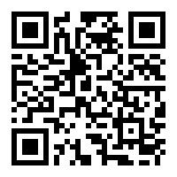
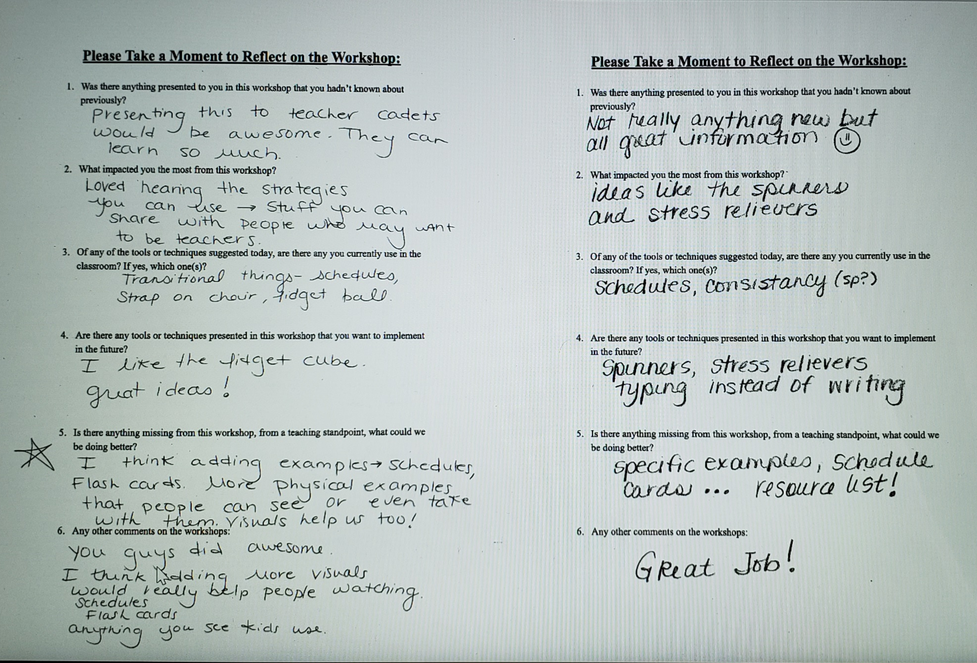
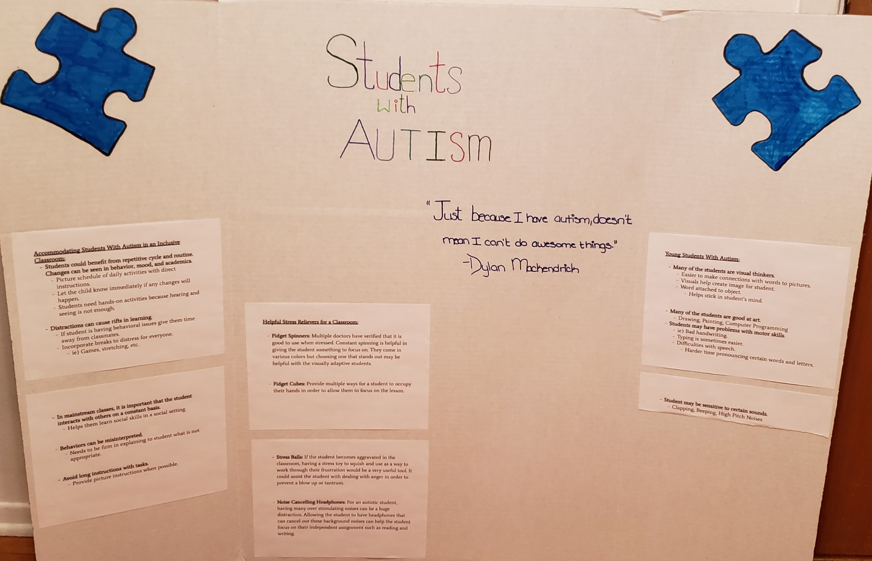
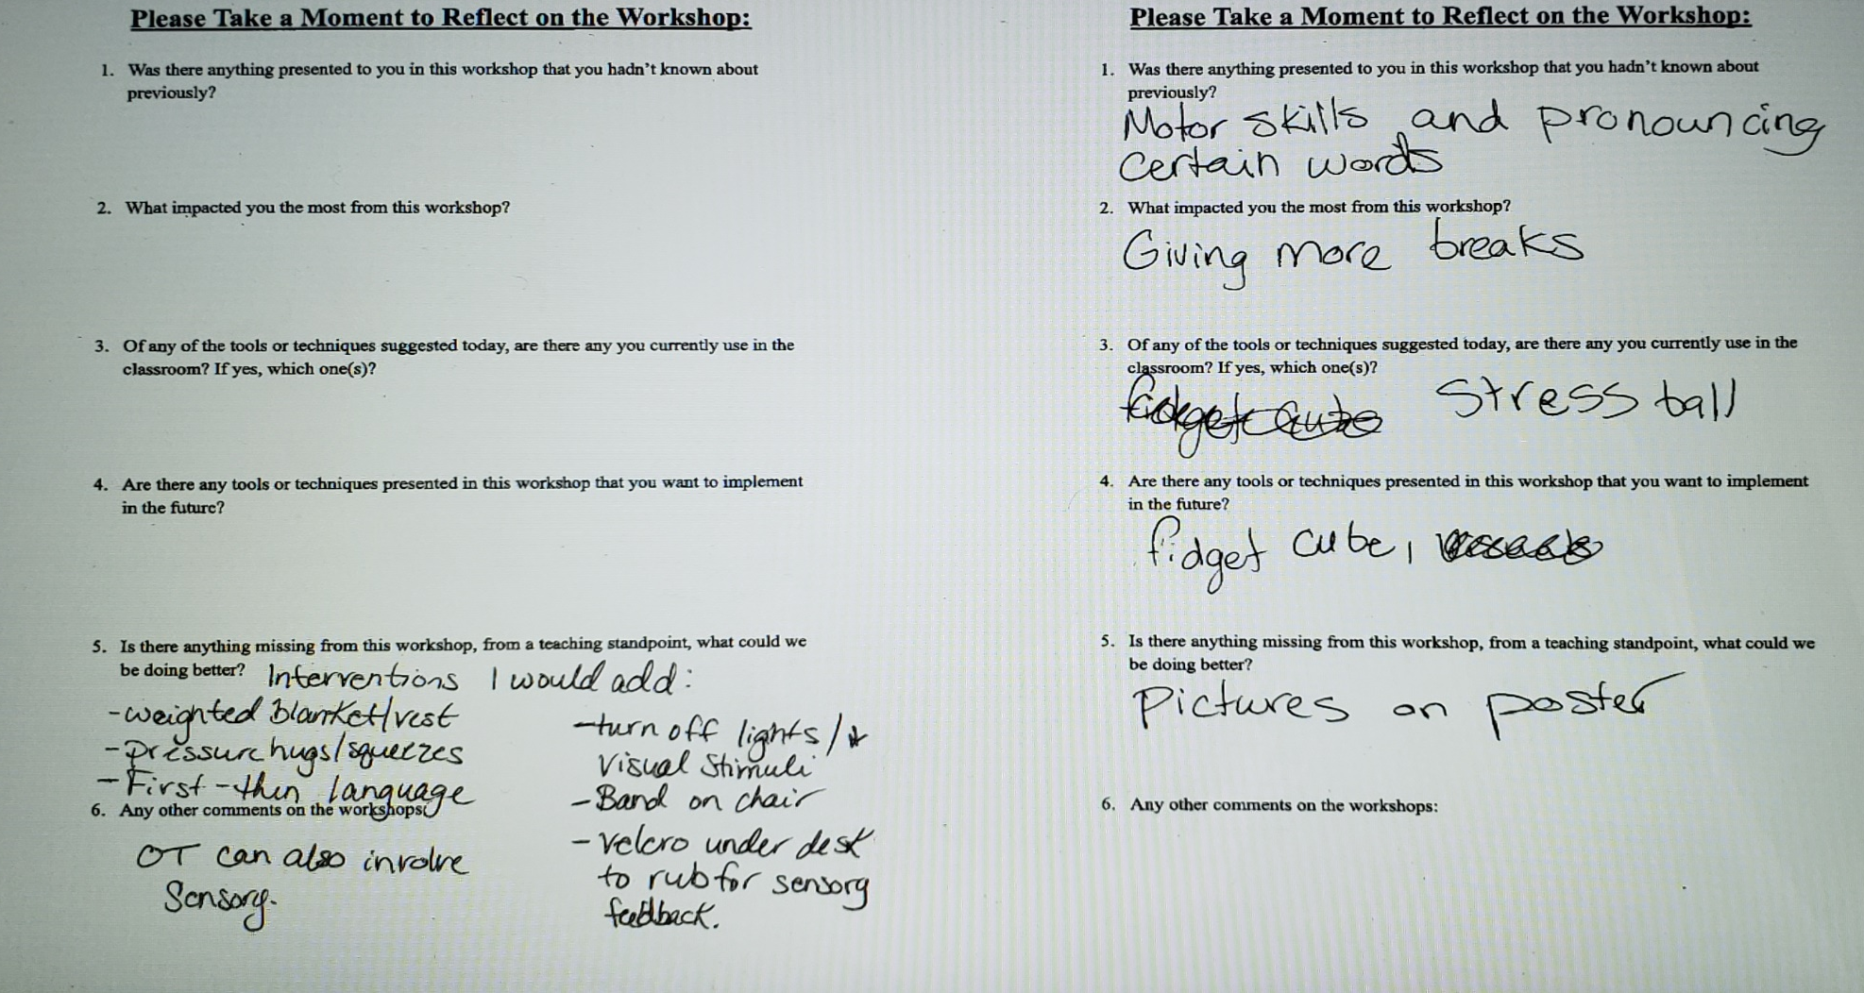
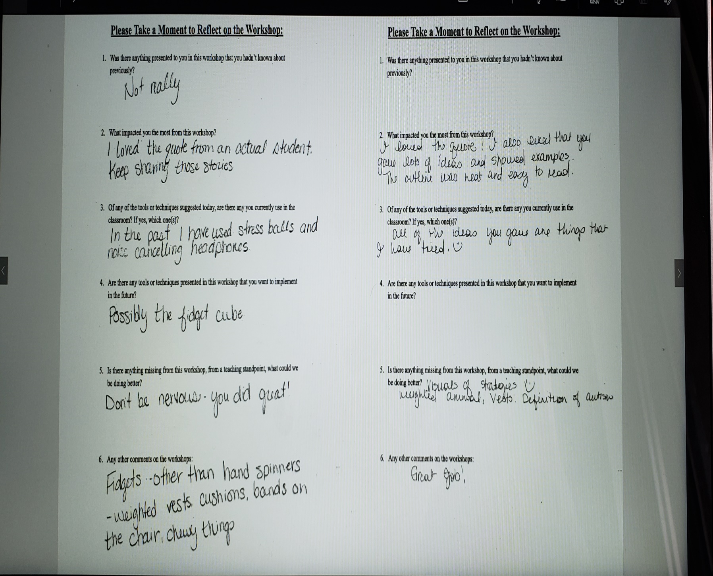
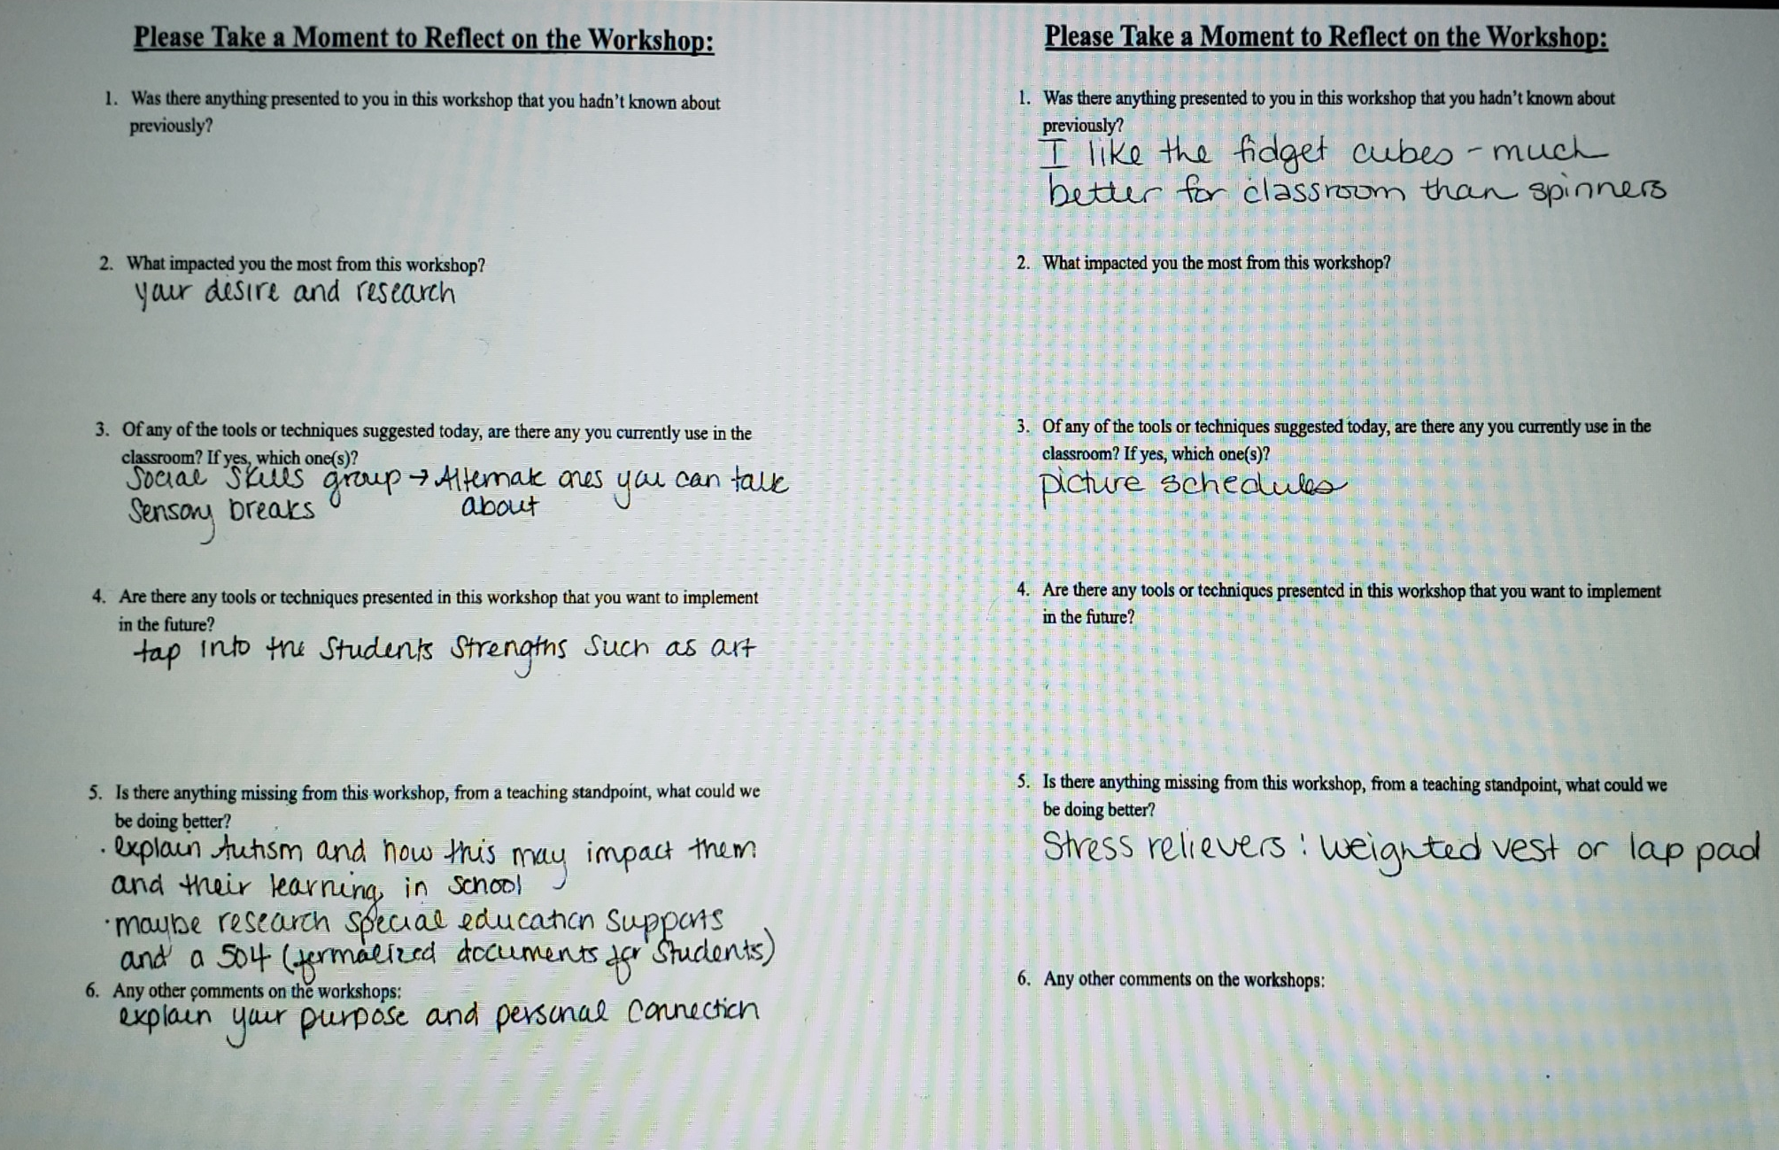
Tools and Techniques for Teachers of Autistic Students
Educate Adams 12 Faculty on expanding their toolbox to help autistic children in the classroom.
Purpose/Introduction
For the Biomedical Capstone, the team’s project is creating workshops to give teachers the necessary training to further their knowledge of the autism spectrum; while expanding their toolbox for the classroom.
Design Process
The group designed workshops to help find ways to calm students with autism. There are a variety of different small objects that can be used to help soothe the child if they are starting to get aggravated. There is cloth, stone, stress ball, fidget toys, and iPads for nonverbal students to communicate with. Students with autism often have a difficult time following the normal flow of a classroom’s curriculum. Adjusting assignments in a few ways can help the student to perform better. Teachers can make clearly defined roles in any group projects. They can have a set schedule or agenda for the class from day to day. Provide students with alternative texts and visuals as they may struggle with abstract concepts. Have models of assignments so the student knows exactly what you’re looking for. Give students a choice in how they present a project or turn in an assignment and a rubric. Above all else, communication is key in the success of learning on any level. Communication between parents, student, and teacher is incredibly important. By having the teacher and the family sit down in the beginning of the school year either at a back to school night, or an “Office Hours” type of setup where the teacher can be available one evening for any concerned parents to come in and discuss with them their student and what would help them.
Results
Background/Literature Review
According to the Autism Society, from 2000 to 2010 the amount of children born with autism has increased from 1 in 150 children to 1 in 68 children in the United States alone. An estimated 3.5 million people have autism spectrum disorder.
Basic flashcards packs were found online at Amazon.com. The packs are sold for the general concepts that children learn at an early age varying from English and nouns to daily activities. Flashcards come in vibrant colors with a large image that they are trying to convey. Sadly, it is a practice that most younger parents are beginning to stray from.
Fidget toys are now commonly found online and in stores at middle range price area. These toys help with nervousness. They come with different textures that are perfect as a quiet stress reliever. One of the biggest perks is they do not cause any disruption/distraction in a traditional classroom setting.
The Four Day Agenda, a four day program for educators teaches them about autism from a medical standpoint. Due to minimal information and knowledge, this workshop series does not provide any benefits for the group. The curriculum taught is from a medical point of view, which does not have the best effect when trying to help teachers form their curriculums.
Analysis
The teachers all had some background knowledge on autism and what it was. They did know of some of the techniques that we have presented like the fidget cubes and spinners. Yet the teachers also brought up that they had some items that they used in the classroom to help the students. The educators noted that the students hit the important parts that needed to be covered, and we might look into presenting to the teacher cadets. They were impressed by the stories that we collected from the interviews that the students managed to incorporate into the workshop. The after surveys did offer many suggestions that the students used to help articulate the next workshop. The teachers said they would like to see more personal stories and visuals of the tools/techniques that we researched. Overall the educators believed that we did a great job for a important cause! The biggest suggestion that was given to the students is to add visuals to the poster board. The group’s goal was to create a positive change for autistic students in the traditional classroom setting. The students provided techniques for the educators on what they can do to better improve their classrooms. The group ran a workshop for the faculty and the educators of North Mor Elementary School. The faculty gave the positive feedback that the teacher cadets would be best for the future presentations as it would be more beneficial. The educators were each given specific handouts that the educators could bring with them to the classroom.
Methodology
Create a prototype workshop.
Run with partnered elementary school.
Provide educators with an Evaluation Google Form.
Provide feedback of workshop experience.
Group will apply feedback to workshop.
Continue to run workshops.
Expand workshops to outside Adams 12.
Acknowledgements
Kasey Nunn: Mentor
Michael Stelling: Counselor
Dylan Mackendrick: NHS Student
The Anonymous Students at Northglenn High School
References
ABC of NC Child Development Center, N. (2017, November 29). FREE Parent and Professional Classes. Retrieved from https://abcofnc.org/services/free-parenting-courses/
A.C.E.C., N. (2015, November 10). High School Students Design Websites for Autism Awareness. Retrieved from https://www.adamscountyeducation.org/news/high-school-website-design/
Amazon.com, N. (2017, December 5). Fidget Toys 7 Pack Sensory Toys by Vital Toys- Includes Liquid Motion Bubbler,Magic Ball,Fidget Cube,Stretchy Strings,Flippy Chain/Ideal Set of Autism Toys/Stress Relief Toys for ADHD,ADD and Anxiety.: Toys & Games. Retrieved from https://www.amazon.com/Toys-Sensory-Vital-Stretchy-Anxiety/dp/B076V3YP9V/ref=sr_1_17?ie=UTF8&qid=1511904487&sr=8-17&keywords=autism
Amazon.com, N. (2017, December 5). Stages Learning Materials Language Builder Picture Noun Flash Cards Photo Vocabulary Autism Learning Products. Retrieved December 5, 2017, from https://www.amazon.com/Stages-Learning-Materials-Language-Vocabulary/dp/B01N9V10IU/ref=sr_1_34_sspa?ie=UTF8&qid=1511904567&sr=8-34-spons&keywords=autism&psc=1
Autism Partnership, N. (2017, December 5). Autism Partnership. Retrieved from https://www.autismpartnership.com/general-information/training-and-staff-development
Autism Supplies & Development, N. (2017, September 5). Autism Supplies And Developments Picture Exchange Communication System Behaviour Keyring: Toys & Games. Retrieved December 5, 2017, from https://www.amazon.com/Autism-Supplies-Developments-Communication-Behaviour/dp/B00JNUSDWA/ref=sr_1_7?ie=UTF8&qid=1511904487&sr=8-7&keywords=autism
Facts and Statistics. (n.d.). Retrieved April 06, 2018, from http://www.autism-society.org/what-is/facts-and-statistics/
Gonzalez, T., & Carter, C. (2017, December 5). CLASSROOM 360 AUTISM TEACHER TRAINING. Retrieved December 5, 2017, from http://www.buildingblox.net/workshops.html
Sails Group, N. (2017, June 19). The Importance of Autism Training for Teachers. Retrieved from http://sailsgroup.org/importance-autism-training-teachers/
Northglenn HS STEM 601 W. 100th Place Northglenn, CO 80260
Alan Knutson and Hailey Mahaffey

