Slide 1
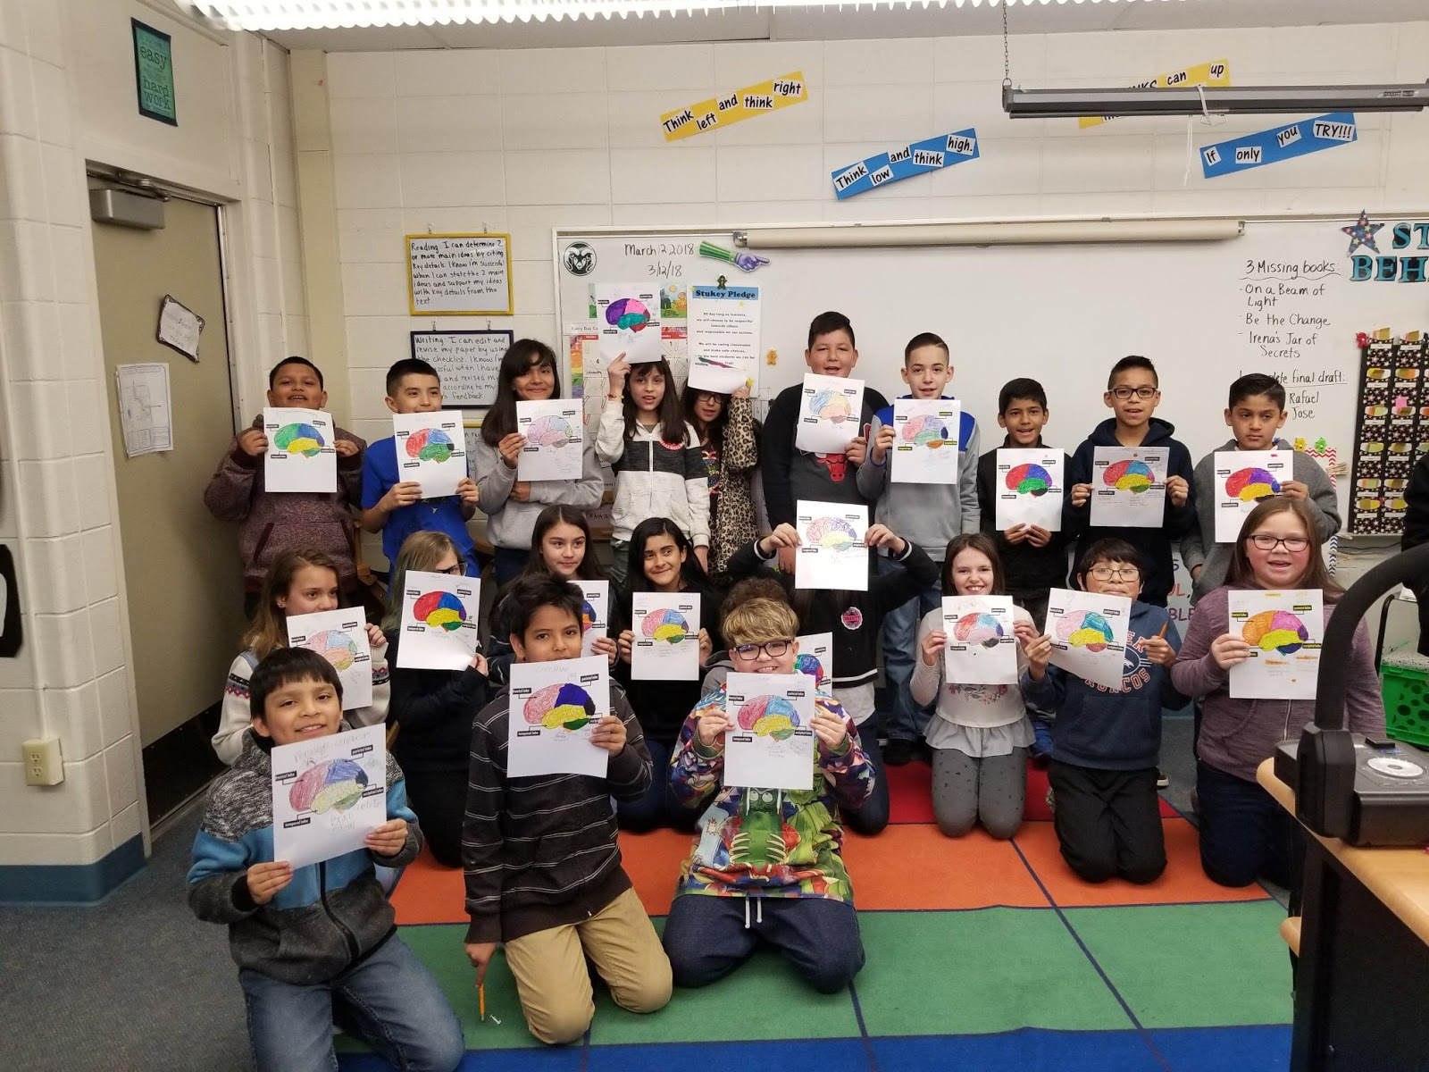
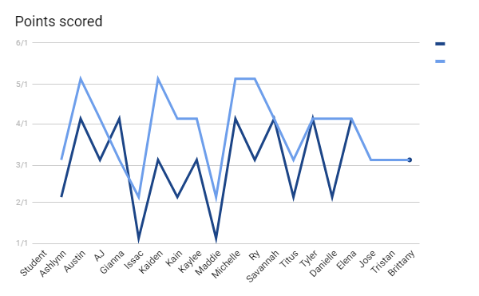
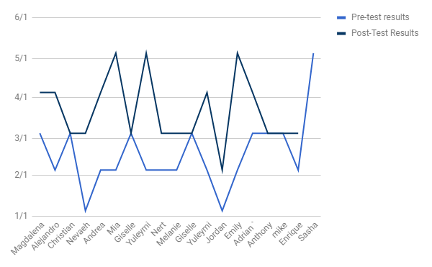
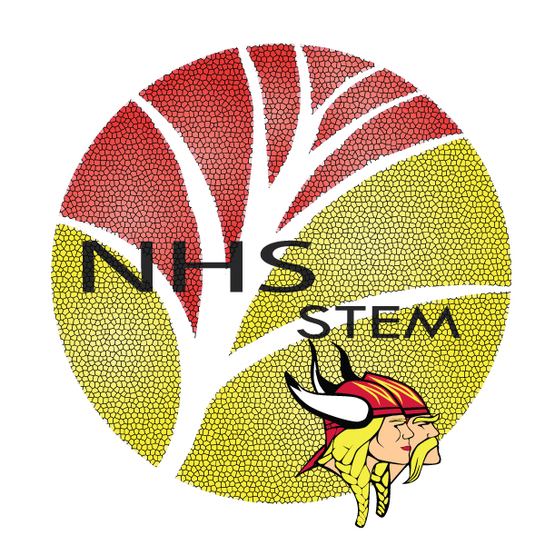
Anatomy In Clay
Lesson plans for Elementary kids
Purpose/Introduction
Design Process and Next Steps
Compared the pre and post test to see if there was any improvement after the anatomy in clay lessons. After the first school, changes were made from recommendations from our teacher and the elementary school teachers. A PowerPoint slide was a recommendation we followed so the students can have a visual on what their maniken is supposed to look like. Another recommendation was from the elementary school teachers, making sure each kid understood each function of their body system was tricky so they suggested having a worksheet to go along with the clay lesson.
Our main goal is to help jumpstart the interest in anatomy and the human body systems earlier in schooling. Students only learn so much from worksheets and presentations. We hope in using hands on activities and clay manikins, to help inspire the next generation to follow into the medical field.
Background/Literature review
Most teachers don't have the opportunity to do hands on learning of the human body. Anatomy in clay allows students to sculpt their own body systems to better understand structures and functions. Having hands on learning lets students observe how the human body is set up and why location is so important. Anatomy in Clay is a company that provides an easier way to teach anatomy with hands on learning with manikins and clay.
Results
Fifth Grade
Stukey Elementary
Fourth Grade
Federal Heights Elementary
Methodology
First, the teachers were contacted to see if they were interested in having the Anatomy In Clay lesson to be taught. Meetings with both schools were held to discuss the dates and resources needed. After the meeting, the skeletal and nervous system lesson plans were taught at Federal Heights Elementary. Each group of four got two sets of manikins and a box of supplies that included different colors and tools. A step by step presentation of what to do was given so the students can follow and have an accurate representation of the body system assigned to them
Analysis
The students improved by 20% form the pretest to the post test. A few students like Tristan, Jose and Kain all improved greatly. Both Tristan and Jose got a 0/5 on their pretests and they both got 3/5 on their post test. Kain got a 2/5 on his pretest and then he got a 4/5 on his post tests. The students improved by 28% from before to after the lesson. The results were from Federal Heights elementary school fourth grade class. Sasha staring the pre-test with a 5/5 to Nevaeh starting with a 1/5. The results show a general trend of improvement or constant scores. The fifth graders showed more interest and understood the content.
Acknowledgements
Stukey Elementary
Federal Heights Elementary
Anatomy in Clay®
Northglenn HS STEM 601 W. 100th Place Northglenn, CO 80260
Sheridan Allen, Maria Aguilar, Allison Maiselles, Elease Mendoza

